Slide 1
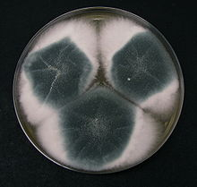
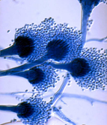
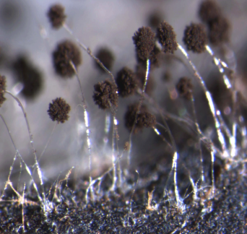
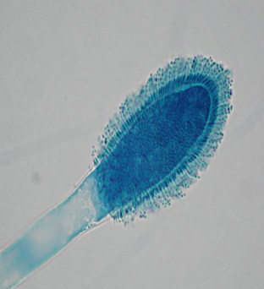
Interpreting MICs and breakpoints for fungi
MYCOCON 2023
Pune, 8.-10.09.2023
Cornelia Lass-Flörl
Institute of Hygiene and Medical Microbiology
Medical University of Innsbruck

Slide 2
Susceptibility data describe how a given isolate, grown under standardised conditions, responds to increasing concentrations of antifungal agents in the laboratory.
The lowest concentration of the drug (mg/L) needed to achieve a given endpoint of suppressed growth is reported as minimum inhibitory concentration (MIC) or minimum effective concentration (MEC).
The growth is influenced by the media, nutrient concentrations, inoculum size, temperature, incubation time, endpoint definition (often in relation to an antifungal free growth control), microplate type, and, finally, antifungal concentrations.
MICs represent a simple method to estimate an antifungal effect in vitro. The microdilution method has become the preferred method.
MICs can also be determined by agar diffusion (Etest, disk) or agar dilution, where the antifungal is incorporated into agar, again in a twofold dilution series, and the inoculum is spotted onto the agar surface prior to incubation.
AFST is indicated for cases of proven or probable IFD, when there is suspicion for acquired resistance, or in cases of refractory or breakthrough disease.

Slide 3
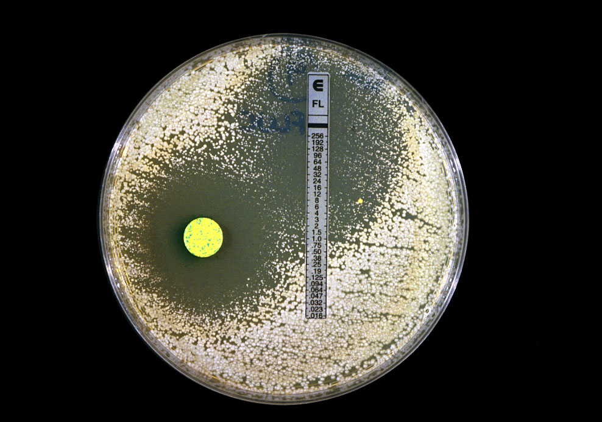
Why Susceptibility Testing?
To provide information for therapy
To provide early warning (R)
To get epidemiological data
To get information for species ID

Slide 4
Antifungal resistance: Testing methods
Broth microdilution (BMD) – yeasts and moulds
- CLSI
- EUCAST
Disk diffusion (DD) – yeasts and moulds
- CLSI
Various commercial products
- Etest
- Vitek 2
- Sensititre YeastOne
- ….

Slide 5
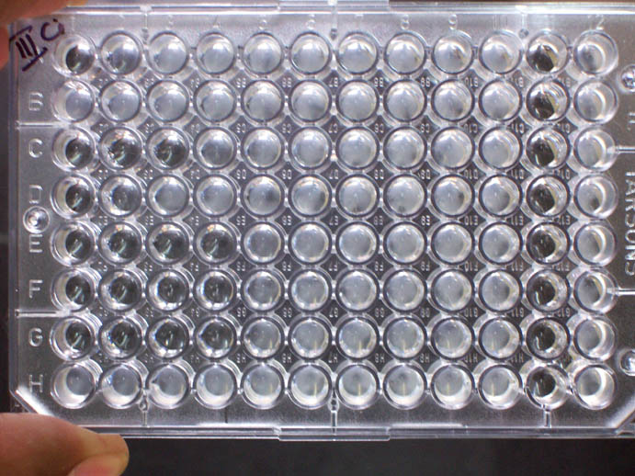
DRUG CONCENTRATIONS
NEG
POS
8mg/L
2mg/L
ENDPOINT
MIC
FUNGAL CONIDIA

Slide 6
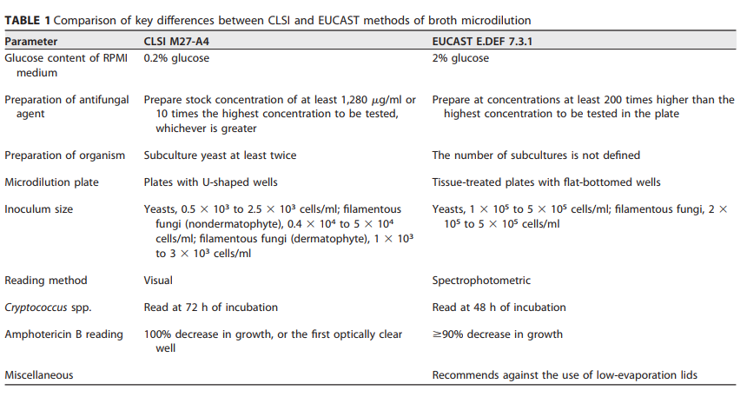

Slide 7
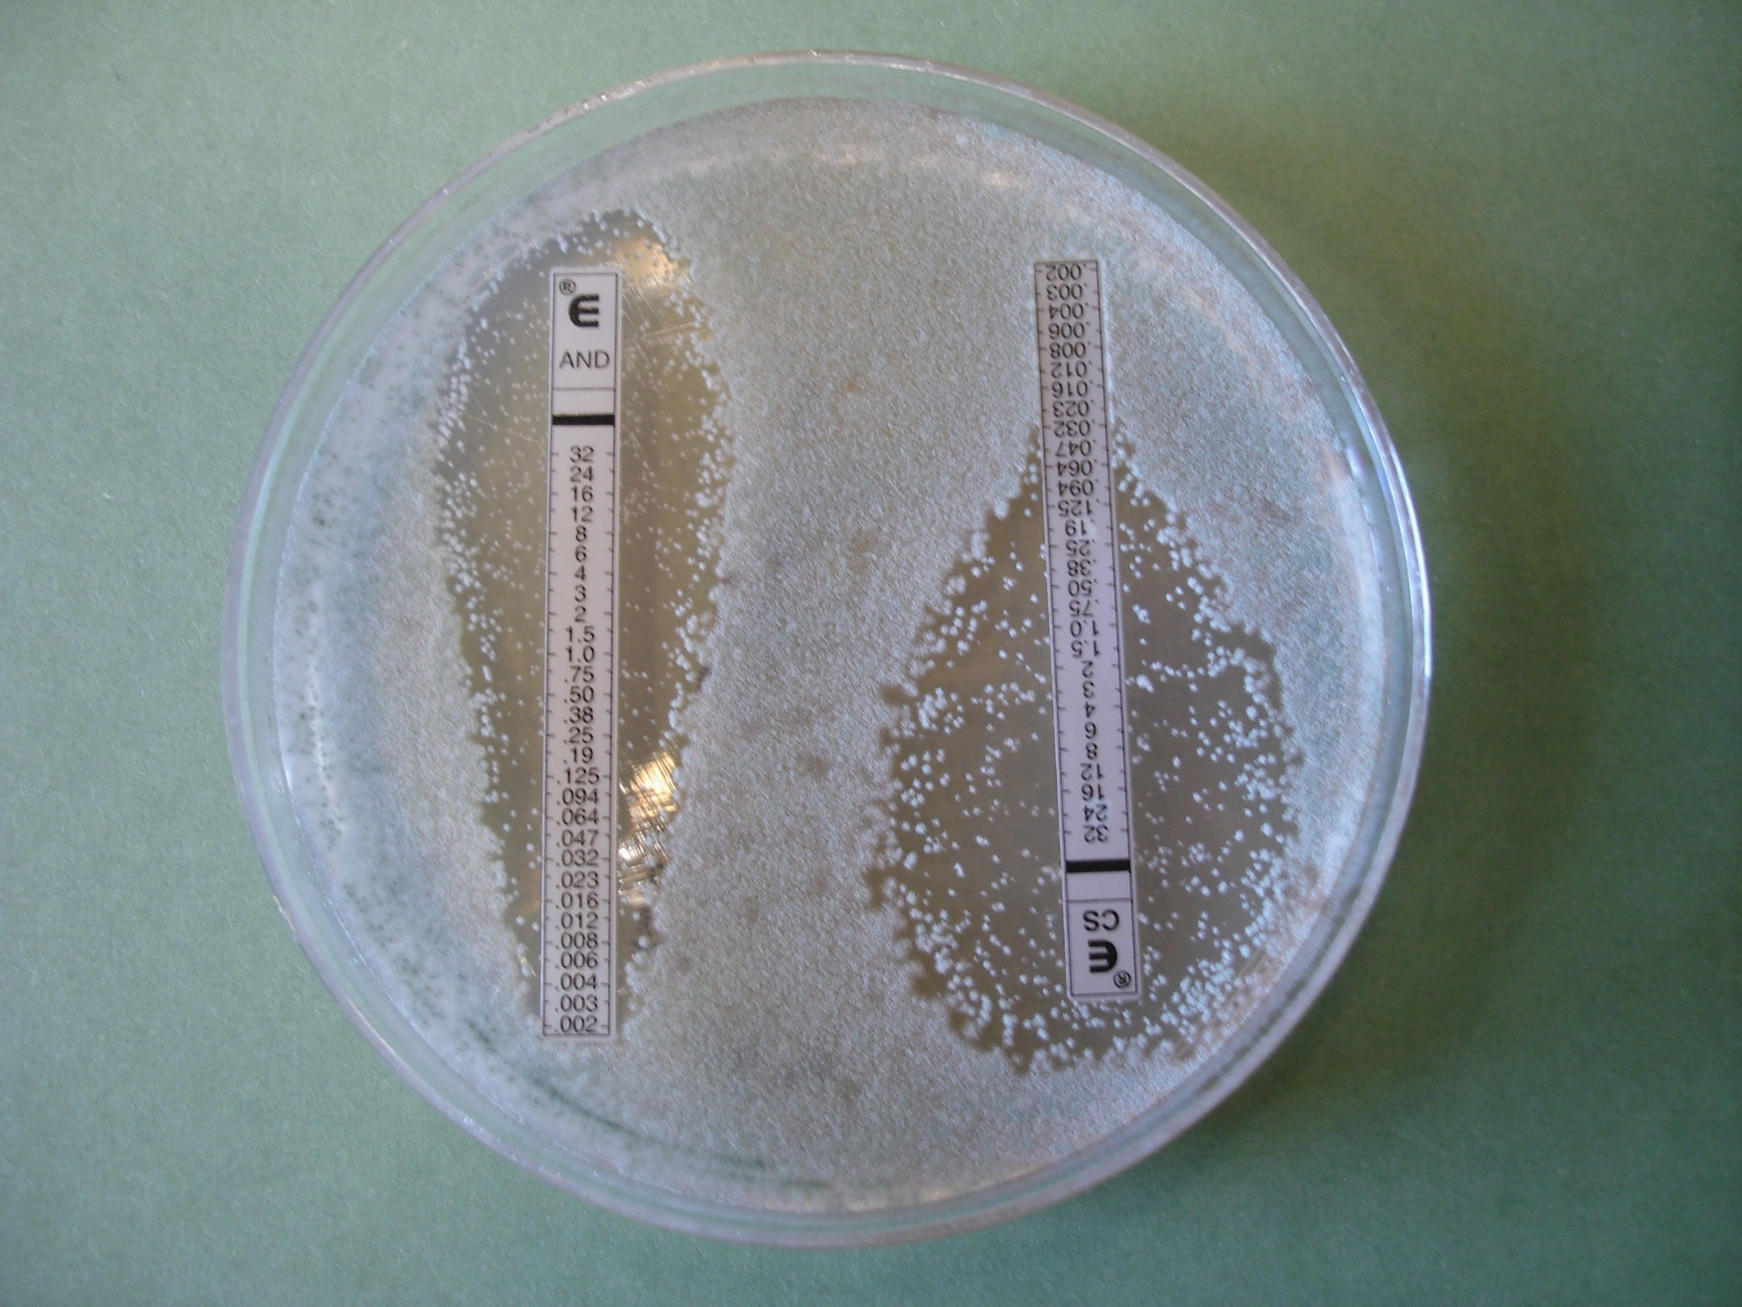
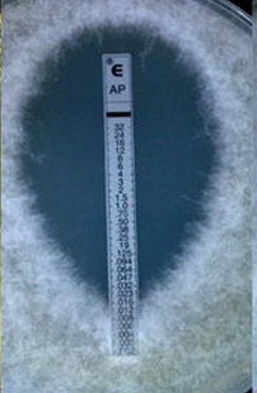
MIC: 0,064 Caspofungin
MIC: 0,016 Amphotericin B

Slide 8
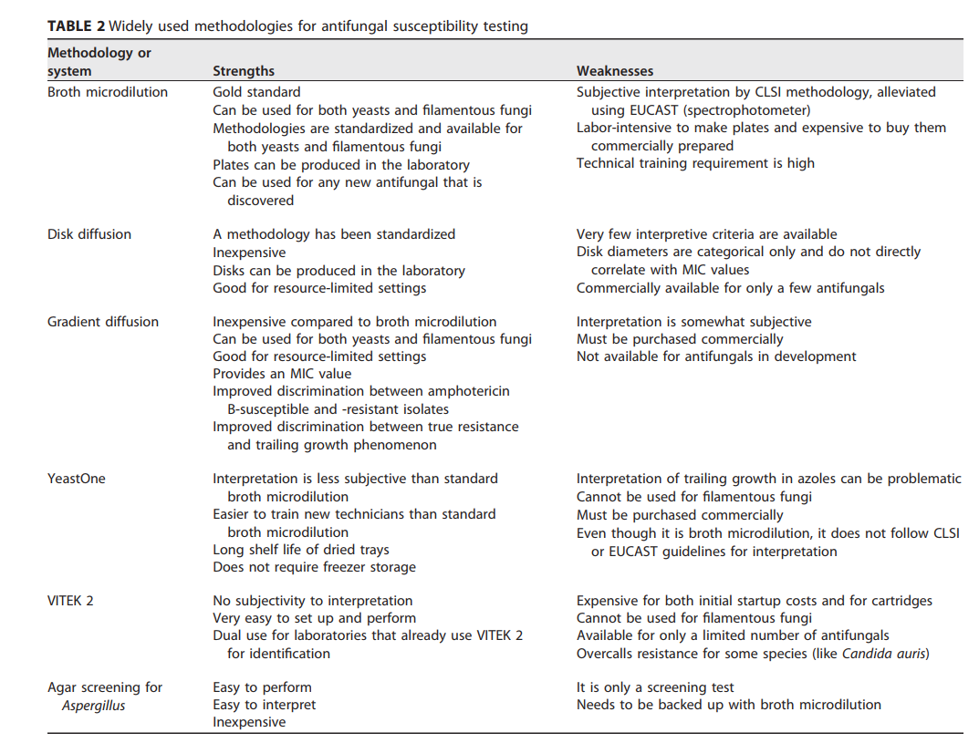

Slide 9
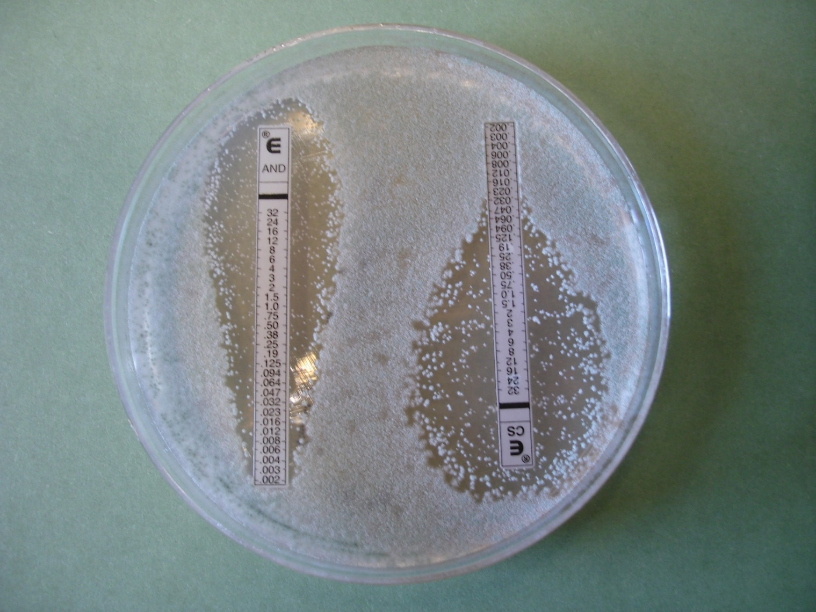
MIC: What does this mean?
Interpretation with help of interpretative criteria:
Breakpoints!

Slide 10
In vitro resistance may be primary (innate, inherent, intrinsic) or secondary (acquired).
Primary resistance is the natural resistance of a fungal order, genus, or species to an antifungal class or a single antifungal agent as a consequence of functional and structural characteristics.
Acquired resistance describes the situation when isolates from a normally susceptible species become less susceptible or resistant, owing to molecular mechanisms such as target gene mutations or target gene or efflux pump upregulation.

Slide 11
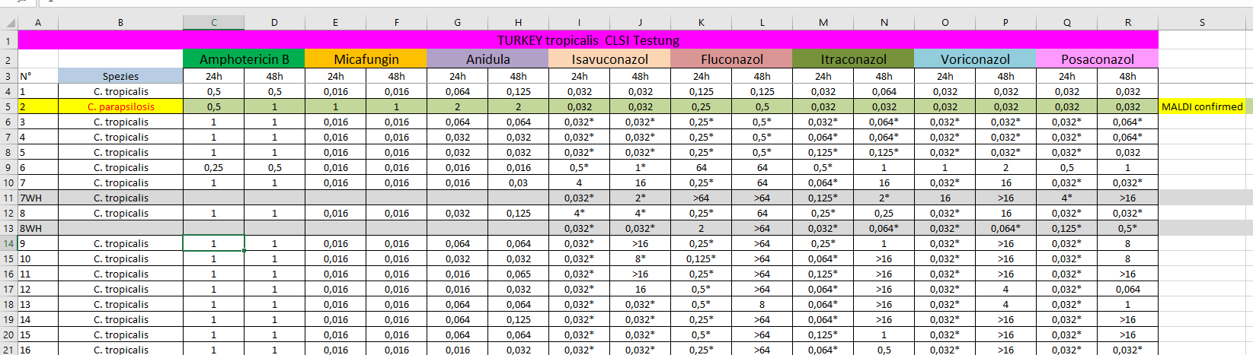
MICs generated, depend on method, species, antifungal drugs,……
ECV
CBP

Slide 12
Epidemiological Cutoff Values
An epidemiological cutoff value (abbreviated ECV using CLSI terminology and ECOFF using EUCAST terminology) denotes the upper limit MIC/MEC values for wild-type strains of a fungal species.
ECV/ECOFFs separate wild-type from non-wild-types.
ECV/ECOFFs do not predict clinical response to therapy.
ECV/ECOFFs have only been defined for a certain number of organism-drug pairings due to the rarity of certain fungal infections, resulting in limited clinical and pharmacological data for each pairing.
ECV/ECOFFs still may be used to guide clinical decision-making when CBPs are not available.
Helps identify organisms requiring further characterization.

Slide 13
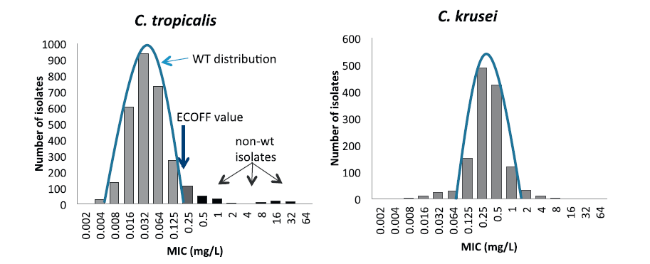
MIC histograms for voriconazole and C. tropicalis (left) and C. krusei (right).
The bell shaped curve indicates the wild type distribution. For C. tropicalis a tail of isolates with higher MICs (black) than the wild type distribution (grey) is seen to the right of the curve, whereas for C. krusei the distribution is symmetrical with no more isolates separating to the right of the curve than to the left.
From: Arendrup et al., Drug Res. Up., 2013

Slide 14
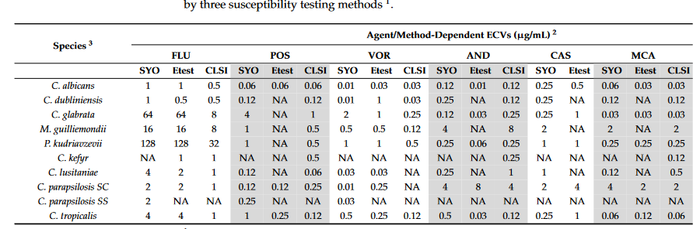
Wild-typ versus non-wild-typ
SYO, SensitireYeastOne
J. Fungi 2022, 8, 309

Slide 15
Clinical breakpoints
ECVs are not always the same as CBPs
CBPs are used to indicate those isolates that are likely to respond to treatment with a given antimicrobial agent administered at the approved dosing regimen for that agent.
Both CLSI and EUCAST consider multiple factors during CBP development, including the MIC distribution for an organism/drug combination, pharmacokinetic properties of each drug, pharmacodynamic factors, common dosing schema, the defined wild-type population, and prior research correlating patient outcomes with specific MIC values.
A CBP is a threshold value that allows for organisms to be classified as susceptible or resistant to a specific antifungal drug.
Turnidge J, Paterson DL. Clin Microbiol Rev. 2007; 20: 391

Slide 16
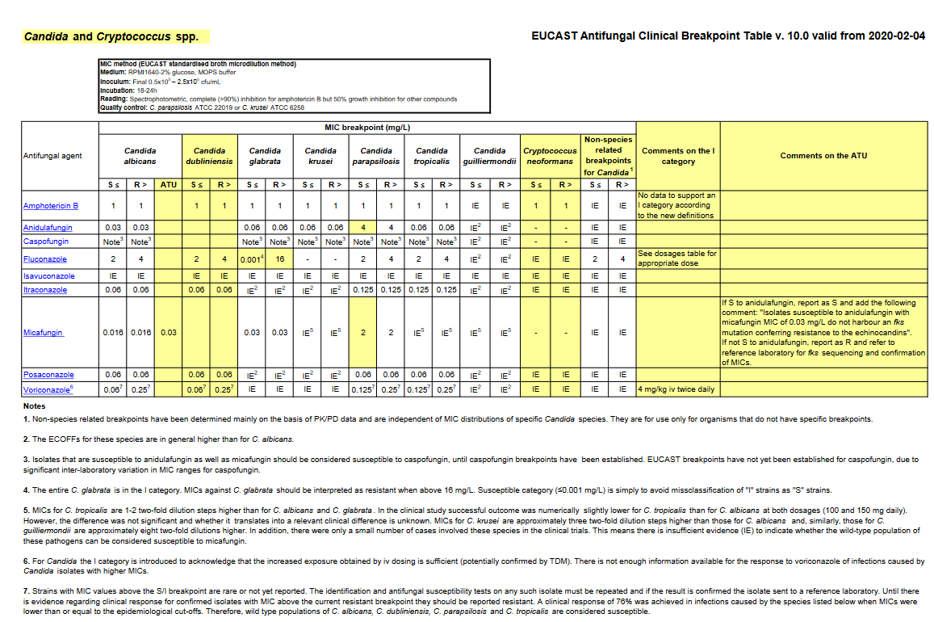

Slide 17
If the isolate’s MIC/MEC is below the defined susceptibility breakpoint the isolate is considered susceptible (S).
If above the defined resistance breakpoint, resistant (R).
CLSI provides a third category, “intermediate (I),” which is used as a buffer zone between S and R for MICs that cannot be easily translated to S or R, and a fourth category, “susceptible-dose-dependent (SDD),” which for antifungals is only used for fluconazole against Candida. This indicates that higher doses of an antifungal drug are needed for a drug to be effective.
EUCAST has a similar designation, “susceptible, increased exposure” (I), where the organism can be regarded as susceptible provided higher exposure is achieved at the site of infection (through increased dosing or physiologic concentration at the site).
EUCAST no longer has an intermediate category. Instead, EUCAST uses the term “area of technical uncertainty” (ATU) when MICs for resistant mutants overlap with the MIC range for susceptible wild-type organisms and the MIC value cannot by itself be classified as susceptible or resistant.
The ATU designation is not to be reported to the clinician but comes with guidance on next steps for laboratories (perform additional testing, etc.) as well as instructions for reporting of MICs to clinicians.
https://www.eucast.org/astoffungi/clinicalbreakpointsforantifungals

Slide 18
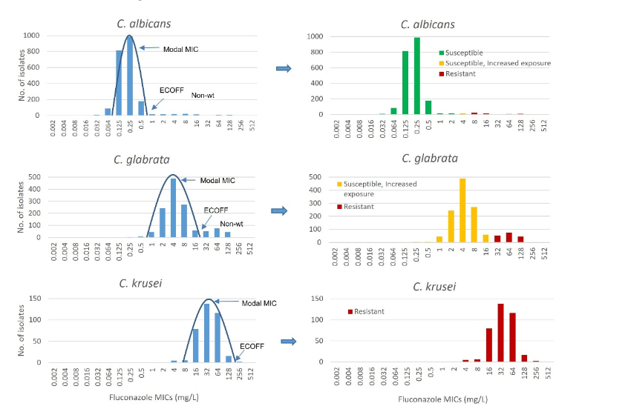
J. Fungi 2022, 8, 141
MIC distributions with applied ECOFFs, clinical breakpoints, and susceptibility classifications for three common Candida species. MIC distributions, ECOFFs, and clinical breakpoints are based on the EUCAST document “Fluconazole: Rationale for the clinical breakpoints,” version 3.0, 2020.

Slide 19
Antifungal Spectrum of Activity Against Common Molds and Yeasts
Organism | AMB | FLU | ITR | POS | VOR | ANI | MFG | CAS | 5FC
Aspergillus fumigatus
Aspergillus flavus
Aspergillus terreus
Aspergillus niger
Aspregillus nidulans
Candida albicans
Candida glabrata
Candida krusei
Candida parapsilosis
Candida guillermondii
Candida lusitaniae
Cryptococcus spp.
Blastomyces
Sporothrix
Fusarium spp.
Pichia spp.
Saccharomyces spp.
Scedosporium apiospermum
Scedosporium prolificans
Trichosporon spp.
Mucorales
AMB, amphotericin; FLU, fluconazole; ITR, itraconazole; POS, posaconazole; VOR, voriconazole; ANI, anidulafungin; MFG, micafungin; CAS, caspofungin; 5FC, flucytosine
antifungal activity against isolates
no or limited activity
variable activity against

Slide 20
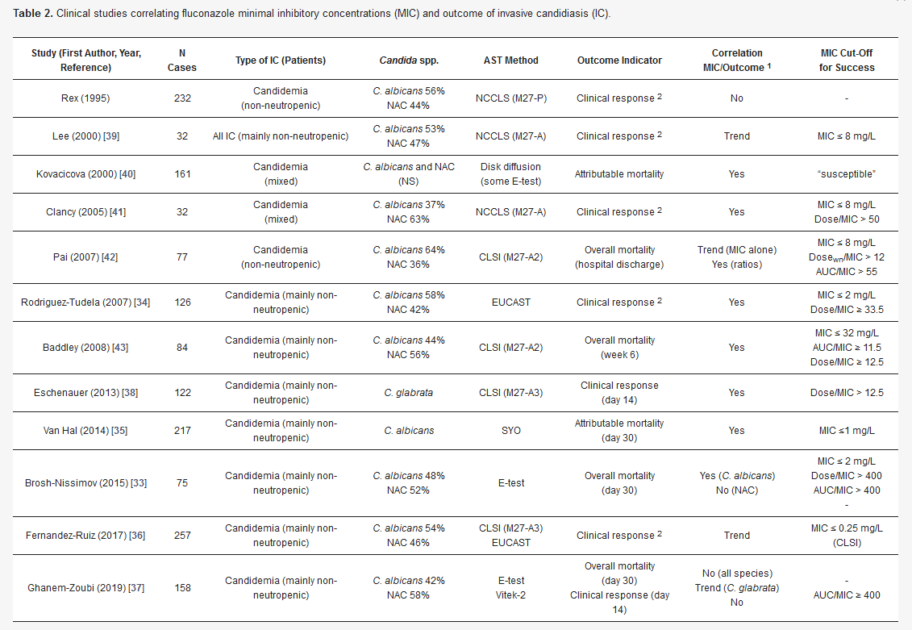
J. Fungi 2021, 7(1), 17

Slide 21
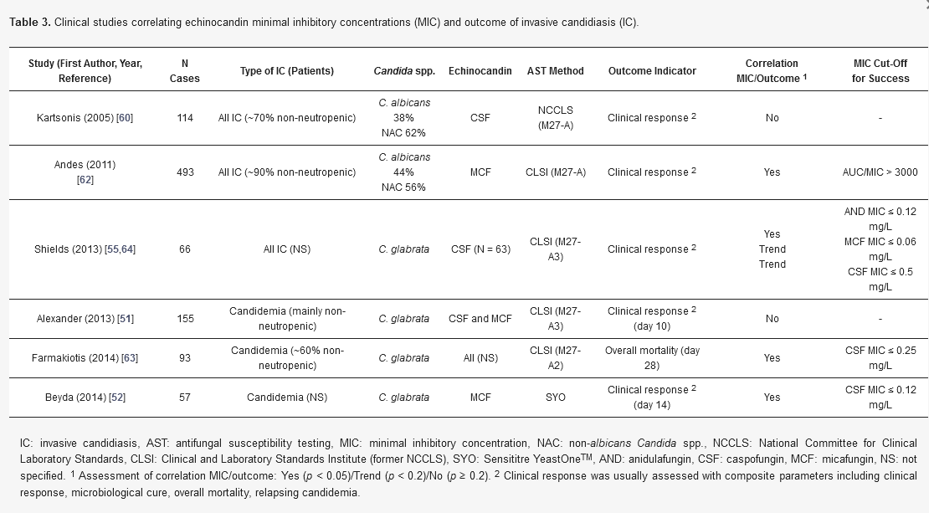
J. Fungi 2021, 7(1), 17

Slide 22
There are several clinical scenarios when AFST is not likely to be clinically informative.
Some fungal organisms have intrinsic resistance to an antifungal agent or class based on functional or structural characteristics:
  echinocandin resistance in Cryptococcus and Rhodotorula spp.
  resistance to fluconazole by Aspergillus spp.
  may develop rapid resistance after a period of exposure: amphotericin B-susceptible Clavispora lusitaniae (formerly Candida lusitaniae).
  AFST also should not be routinely performed for fungal organisms in cultures obtained from non-sterile sites unless the patient is a risk for fungal disease, as these cultures should not routinely prompt therapy.

Slide 23
The 90-60 rule observes that infections due to susceptible isolates respond to appropriate therapy ~90% of the time, whereas infections due to resistant isolates (or infections treated with inappropriate drug) respond ~60% of the time.
Rex JH and Pfaller MA. CID 2002, 35: 982

Slide 24
My thoughts
Which method – validate yourself
ECV – rough classification
CBP – not for all drug/bugs; no clinical validation yet!
AFST: breakthrough infections, suspicion of resistant strains
AFST: according to local epidemiology
AFST: based on species identification? C glabrata (FLU R)
Differentiate between prim. resistance from sec. resistance
Testing: biological variation (within 3 log steps)
MIC uncertain for Mucorales, non Aspergillus, rare yeasts, rare Aspergillus
MIC is a guidance (clinical resistance versus lab resistance)

Slide 25

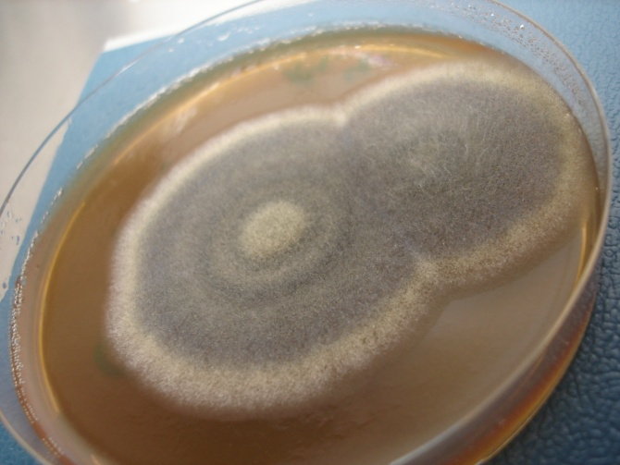

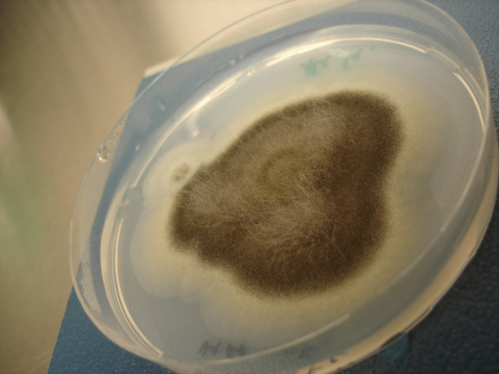
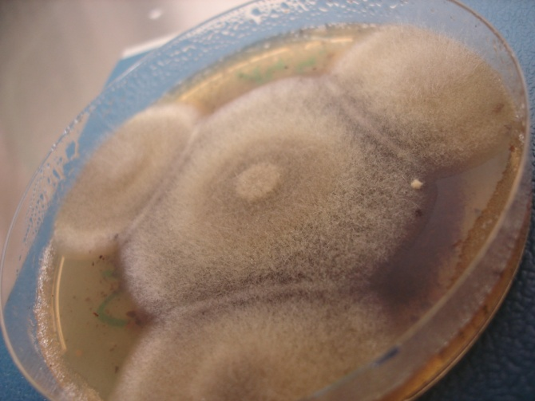
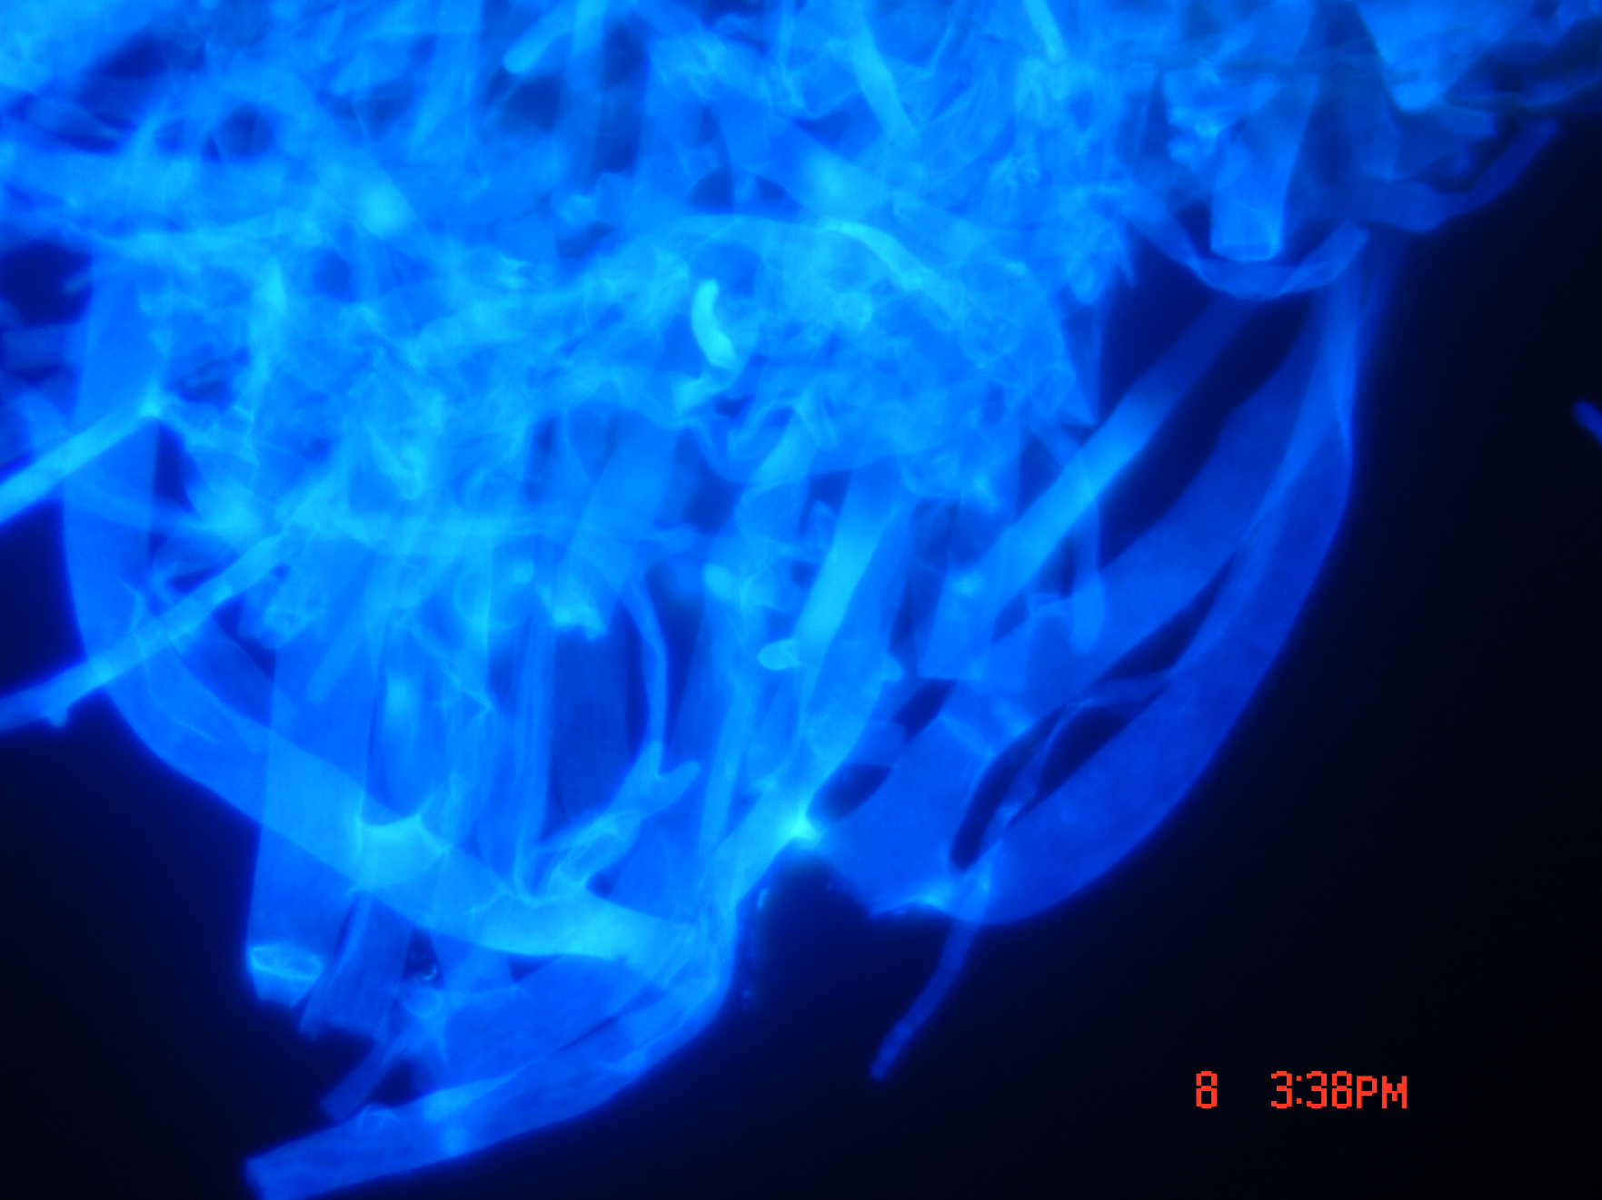
Thank you very much for your attention!

Slide 26
Antifungal susceptibility testing (AFST) provides in vitro measurements of the concentration of an antifungal agent that inhibits growth of a given fungal organism: the minimum inhibitory concentration (MIC) or minimum effective concentration (MEC).
While first-line therapies have been determined for the most common fungal pathogens, the emergence of resistant organisms such as Candida auris, triazole-resistant Aspergillus fumigatus, or fluconazole-resistant Candida species highlights the need for antifungal susceptibility testing (AFST).
For common pathogens and systemic antifungal agents, clinical breakpoints (CBP) are available; to inform whether the identified MIC/MEC equates to a susceptible or resistant isolate.
AFST is indicated for cases of proven or probable IFD, when there is suspicion for acquired resistance, or in cases of refractory or breakthrough disease.

