Slide 1
New azoles in the management of
invasive mould infections:
isavuconazole and posaconazole
Dr. Johan Maertens, MD, PhD
Department of Hematology, University Hospital Gasthuisberg
Department of Microbiology, Immunology, and Transplantation, KULeuven
Leuven, Belgium

Slide 2
Conflicts of Interest
Received grants, speaker’s fee, ad board honoraria and/or travel support from
Gilead Sciences
Pfizer Inc.
MSD
Astellas
Basilea Pharmaceuticals
Bio-Rad laboratories
IMMY
OLM
PathoNostics
F2G
Scynexis
Amplyx
Cidara
Vical
Mundipharma
Takeda

Slide 3
New azoles in the management of invasive aspergillosis isavuconazole (SECURE study)- key study results
Fewer drug-related adverse events were reported with isavuconazole (109 [42%] patients) than with voriconazole (155 [60%] patients), particularly those affecting eye, hepatobiliary system, and skin
Maertens J, et al. Lancet 2016; 387: 760-769

Slide 4
New azoles in the management of invasive aspergillosis posaconazole - key study results
Fewer drug-related adverse events (ITT population) were reported with posaconazole (30%) than with voriconazole (40%), particularly those affecting eye and psychiatric disorders (hallucinations). More metabolism (hypokalemia) and nutrition disorders (decreased appetite) with posaconazole
Maertens J, et al. Lancet 2021; 397: 499-509

Slide 5
First-line treatment of invasive aspergillosis: mortality outcomes
Marr K, et al. Annals of Internal Medicine 2015; 162: 81-89
Maertens J, et al. Lancet 2016; 387: 760-769
Maertens J, et al. Lancet 2021; 397: 499-509

Slide 6
First line invasive aspergillosis: recommendations
Drugs | IDSA¹ (strength of recommendation; strength of evidence) | ECIL² | ESCMID-ECMM-ERS³ | Australia⁴ | Taiwan⁵
AmB deoxycholate | - | AI against use | DI | - | Strong Moderate quality
Liposomal AmB | Strong Moderate quality | BI | BII | BII | Strong Moderate quality
AmB lipid complex | Weak Low quality | BII | CIII | -
AmB colloidal dispersion | Weak Low quality | CI | DI | -
Itraconazole | - | CIII | CIII | - | Weak moderate-quality
Posaconazole | - | - | - | AI | Weak moderate-quality
Voriconazole | Strong High quality | AI | AI | AI | Strong High quality
Isavuconazole | Strong Moderate quality | AI | AI | AI | -
Caspofungin | Not recommended | CII | CII | CII | Weak moderate-quality
Micafungin | Weak moderate-quality |  | CIII | CII | Weak moderate-quality
Combination voriconazole plus anidulafungin | Weak Moderate quality | CI | CI | CI | Not routinely recommended
Other combinations | - | CIII | DIII | - | -
¹Patterson TF, et al. Practice Guidelines for the Diagnosis and Management of Aspergillosis: 2016 Update by the Infectious Diseases Society of America. Clin Infect Dis. 2016;63(4):433–42.
²Tissot F, et al. ECIL-6 guidelines for the treatment of invasive candidiasis, aspergillosis and mucormycosis in leukemia and hematopoietic stem cell transplant patients. Haematologica. 2017;102(3):433-44. ³Ullmann AJ, et al. Diagnosis and management of Aspergillus diseases: executive summary of the 2017 ESCMID-ECMM-ERS guideline. Clin Microbiol Infect . 2018; 24 Suppl 1:e1-e38.
⁴Douglas AP, et al. Consensus guidelines for the diagnosis and management of invasive aspergillosis, 2021. Internal Medicine Journal. 2021; 51 (Suppl 7): 143-176.
⁵Kung H-C, et al. 2016 guidelines for the use of antifungal agents in patients with invasive fungal disease in Taiwan. Journal of Microbiology, Immunology, and Infection. 2018; 51: 1-17

Slide 7
Will the new azoles replace voriconazole as standard of care for the primary treatment of invasive aspergillosis? E.g., isavuconazole
Broader spectrum of activity (including some mucormycetes)
Once-daily dosing after the loading dose
Linear pharmacokinetics
Less interpatient variability in exposure
Water solubility (no need for cyclodextrin in the intravenous formulation)
No prolongation of QT/QTc
Better tolerability profile
Fewer CYP enzyme-mediated drug-drug interactions
Clinicians have learnt to manage voriconazole side effects, drug interactions, concentrations, and CYP2C19 genotypes in clinical practice
The day 42 mortality in both groups is not different from the 18,8% mortality seen in the pivotal study done 20 years ago*
Voriconazole has become off-patent in many countries and is now available as a cheaper treatment option
* Herbrecht R, et al. N Engl J Med 2002347: 408-415

Slide 8
Will the new azoles replace voriconazole as standard of care for the primary treatment of invasive aspergillosis? E.g., isavuconazole
Broader spectrum of activity (including some mucormycetes)
Once-daily dosing after the loading dose
Linear pharmacokinetics
Less interpatient variability in exposure
Water solubility (no need for cyclodextrin in the intravenous formulation)
No prolongation of QT/QTc
Better tolerability profile
Fewer CYP enzyme-mediated drug-drug interactions

Slide 9
New azoles in the management of invasive aspergillosis isavuconazole and posaconazole baseline study characteristics
Baseline study characteristic | Isavuconazole study arm (N=258) | Posaconazole study arm (N=288)
Mean body weight (SD) | - | 68,6 (16,1) kg
Mean body-mass index (kg/m²) | 24,2 | -
Underlying hematological disease | 216/258 (83,7 %) | > 70 %
Absolute neutrophil count < 500/mm³ | 63 % | 46 %
Allogeneic hematopoietic cell transplantation | 21 % | 23 %
Mould-active azole prophylaxis (> 4 days)* | 0 % | 0 %
Lower respiratory tract disease (LRTD) only Non- LRTD only | 81 % 10 % | 83 % 4 %
Exclusion criteria | Cardiovascular findings, at risk for QT prolongation, baseline hepatic dysfunction, moderate-to-severe renal dysfunction (8% had an eGFR-MDRD < 60 mL/min per 1,73 m²) | Cardiovascular findings, at risk for QT prolongation, baseline hepatic dysfunction, severe renal dysfunction (eGFR-MDRD < 20 mL/min per 1,73 m²)
* For specific details: see supplementary appendices
Maertens J, et al. lancet 2016: 387: 760-769
Maertens J, et al. Lancet 2021; 397: 499-509

Slide 10
New azoles in the management of invasive aspergillosis isavuconazole and posaconazole, limitations of the studies
Most patients were undergoing treatment for hematological malignant disease
Patient were not receiving mould-active triazole prophylaxis
Few patients had mould infections other than invasive aspergillosis (A. fumigatus)
More than 80% of the fungal diseases were LRTD only
Voriconazole therapeutic drug monitoring and dose adaptation was not done (samples were collected for retrospective analysis but results are not always available) and oral dosing was not weight adjusted
Although isavuconazole through levels at day 14 (3354 ng/mL) were like those in healthy volunteers, more data is needed in specific situations

Slide 11
Posaconazole bioavailability of the solid oral tablet is reduced during severe intestinal mucositis
Mucositis was defined based on daily plasma citrulline measurement as surrogate for the small intestine enterocyte mass
Jansen A, et al Clin Microbiol Infect 2022; 28: 1003-1009 .

Slide 12
#1. Isavuconazole is less hepatotoxic?

Slide 13
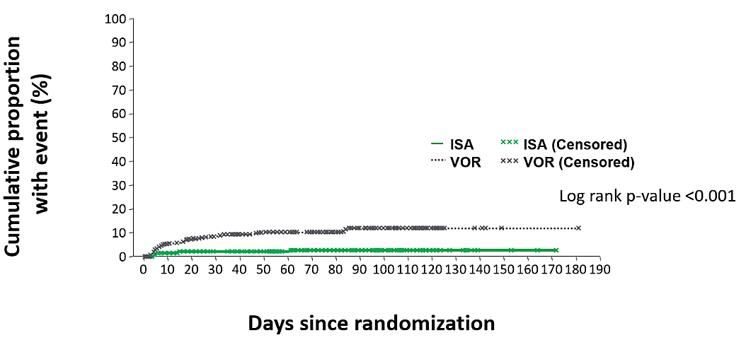
Isavuconazole versus voriconazole (SECURE) study Cumulative incidence of study drug-related hepatobiliary TEAEs
100
90
80
70
Cumulative proportion
with event (%)
60
50
ISA
VOR
ISA (Censored)
VOR (Censored)
40
30
Log rank p-value <0.001
20
10
0
0
10
20
30
40
50
60
70
80
90
100
110
120
130
140
150
160
170
180
190
Days since randomization
Ullmann A, et al. ECCMID 2015, Copenhagen Denmark, April 25–28, 2015, EPO18

Slide 14
Isavuconazole versus voriconazole (SECURE) study Cumulative incidence of study drug-related hepatobiliary TEAEs and lab values
VOR
ISA
% patients with ≥1 TEAE
% patients with
≥1 occurrence at EOT
Any TEAE | Hyperbili-rubinaemia | Hepatic function abnormal | Jaundice | Hepatitis | Hepatic failure
>3 x ULN | >5 x ULN | >10 x ULN | >20 x ULN | ALT or AST >3 x ULN plus total bilirubin >2 x ULN (Hy’s case)
ALT or AST
Ullmann A, et al. ECCMID 2015, Copenhagen Denmark, April 25–28, 2015, EPO18

Slide 15
Isavuconazole after posaconazole hepato-toxicity in leukaemia patients
DiPippo AJ et al. Tolerability of Isavuconazole After Posaconazole Toxicity in Leukaemia Patients. Mycoses 2019; 62: 81-86

Slide 16
Is isavuconazole less hepatotoxic?
Causes of premature discontinuation of antifungal prophylaxis in lung transplant recipients
Samanta P, et al. Clin Infect Dis 2021; 73: 416

Slide 17
#2. No need for therapeutic drug monitoring with isavuconazole?

Slide 18
Isavuconazole: exposure-response Lack of any statistically significant relationship
Outcome
MIC pathogen
OR @ EOT
Drug exposure
AUC/MIC
C_{ss}
AUC_{ss}
ACM 42
OR: overall response
MIC: minimal inhibitory concentration
AUC_{ss}: area under the concentration-time curve at steady state
C_{ss}: mean through concentration at steady state
ACM: all cause mortality
Desai A, et al. Exposure-Response Relationships for Isavuconazole in Patients with Invasive Aspergillosis and Other Filamentous Fungi.
Antimicrob Agents Chemother. 2017; 61(12)

Slide 19
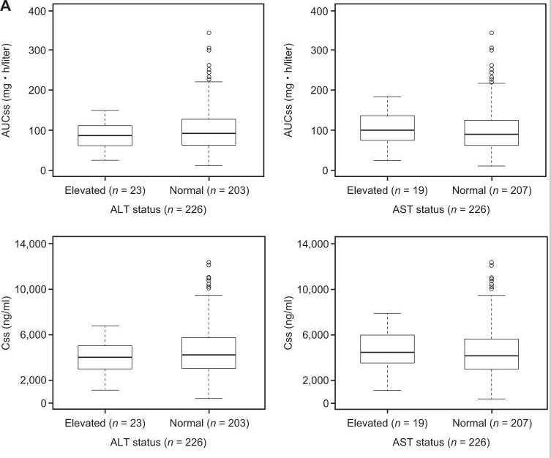
Isavuconazole: exposure-hepatic safety Lack of any statistically significant relationship
Desai A, et al. Exposure-Response Relationships for Isavuconazole in Patients with Invasive Aspergillosis and Other Filamentous Fungi.
Antimicrob Agents Chemother. 2017; 61(12)

Slide 20
Pharmacokinetic relationships in the double-blind randomized study of posaconazole and voriconazole for treatment of invasive aspergillosis
 | Posaconazole | Voriconazole
Day 42 all-cause mortality¹ | 15% | 21%
Mean C_{trough}, ng/mL | ~1500 weeks 1 through 4 | Week 1, ~4200 Week 4, ~2200
Day 42 mortality: exposure-efficacy trend by quartile | No trend | Highest in those in highest C_{trough} quartile (6% Q1 vs 39% Q4)
Global clinical response week 6, success vs failure: exposure-efficacy trend by quartile | No trend | Highest C_{trough} quartile had most failures (27% Q1 vs 77% Q4)
TRAEs: exposure-safety trend by quartile | Overall lower than voriconazole; most TRAEs in highest C_{trough} quartile | No trend, including for CNS and visual Tier 1ª AEs
CYP2C19 metabolizer phenotype² | Not evaluated | No effect
1. Maertens JA et al. Lancet. 2021;397:499-509. 2. Maertens JA et al. Lancet. 2021; 398: 578-579.
Presented at the 31st European Congress of Clinical Microbiology & Infectious Diseases, 9 - 12 July 2021 (submitted)
Notes:
As first-line treatment, posaconazole was non-inferior to voriconazole for all-cause mortality up until day 42 in subjects with invasive aspergillosis¹
Pooled mean C_{trough} posaconazole was ~1500 ng/mL throughout the study
Pooled mean C_{trough} voriconazole was ~4200 ng/mL at Week 1, then decreased approximately 50% over the first 4 weeks of dosing
For posaconazole-treated subjects, there was no discernible trend across C_{trough} quartiles for either all-cause mortality through Day 42 or success vs. failure in global clinical response at Week 6
For voriconazole-treated subjects, all-cause mortality through Day 42 was highest in the highest quartile of C_{trough}
A similar pattern was observed in global clinical response at Week 6
Overall, posaconazole TRAEs were less frequent than voriconazole TRAEs (29.9% vs. 40.1%)
Among posaconazole-treated subjects, while the proportion of subjects with TRAEs was highest in the highest quartile of exposure, comprised of alanine aminotransferase increased, nausea, and vomiting.
Among voriconazole-treated subjects, the incidence of TRAEs (including visual and CNS AEs) was similar across all quartiles exposure
CYP2C19 metabolizer phenotype did not appear to contribute to the therapeutic response or TRAEs seen with voriconazole²
These results support the first-line use of posaconazole for the treatment of invasive aspergillosis

Slide 21
Isavuconazole: need for therapeutic drug monitoring (TDM)?
No clear evidence that there is a general need for TDM or a clear target to recommend
Post-hoc analysis of SECURE study: 97% of patients had ISA >1 and < 7 mg/L
Real world data (Andes et al. AAC 2018): >90% had ISA > 1 mg/L
There is a lower need compared to voriconazole and posaconazole
However, TDM may be considered for individual cases
Prolonged use of isavuconazole (several months-increased risk of high levels)
Severe gut disease from graft-versus-host disease
Treatment of central nervous system infections
Infections with non-wild-type fungal pathogens
Children and adolescents and obese patients
Unresponsive to treatment of breakthrough
Concomitant use of flucloxacillin²
Critically ill patients, irrespective of RRT and/or ECMO³
Desai A, et al. Exposure-Response Relationships for Isavuconazole in Patients with Invasive Aspergillosis and Other Filamentous Fungi.
Antimicrob Agents Chemother. 2017; 61(12)
²Van Daele R, et al. Mycosis 2021; 64: 1508-1511:
Mertens B, et al. Crit Care 2022; 26: 227-

Slide 22
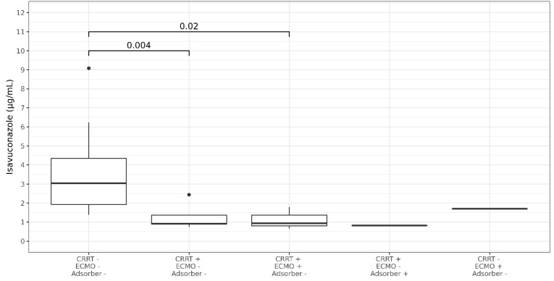
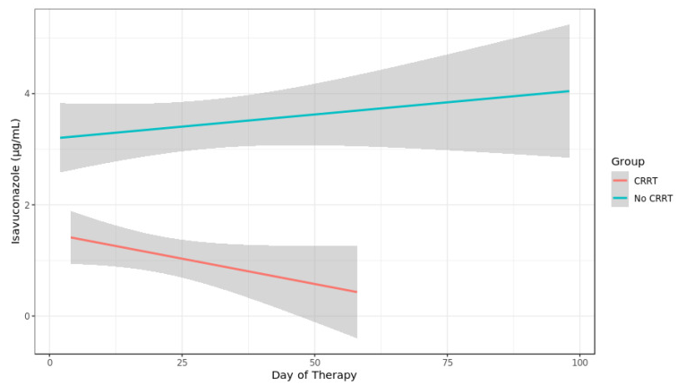
Isavuconazole in CRRT and/or ECMO
An independent effect of ECMO on mould-active azole exposure
could not be confirmed in retrospective and prospective studies
CRRT; continuous renal replacement therapy, ECMO; extracorporeal membrane oxygenation
Zurl C et al. J Fungi 2020; 6: 90

Slide 23
#3. Isavuconazole is safer for long-term administration?

Slide 24
Adverse effects associated with long-term administration of azole antifungal agents
Azole | Fluoride excess & periostitis | Myositis & peripheral neuropathy | Alopecia | Xerosis | Hormone-related* | Photo-toxicity | Irreversible hepato- toxicity | pancreatitis
Fluconazole | + (<5%) | + (<5%) | ++ (5-10%) | ++ | + (<5%) | NR | + (<5%) | NR
Itraconazole | NR | +++ | NR | NR | + (<5%) | NR | + (<5%) | + (<5%)
Voriconazole | ++ (5-10%) | ++ (5-10%) | ++ (5-10%) | NR | + (<5%) | ++ (5-10%) SOT/HCT > 10% | + (<5%) | + (<5%)
Posaconazole | + (<5%) | + (<5%) | + (<5%) | NR | + (<5%) | NR | + (<5%) | NR
* gynecomastia, breast tenderness, adrenal insufficiency, hyponatremia, hypokalemia
NR, not reported; SOT, solid organ transplant; HCT, hematopoietic cell transplant
Modified after Benitez LL and Carver PL. Drugs 2019; 79: 833-853

Slide 25
‘Lack of toxicity’ with long-term (>6 months)* isavuconazole use in patients with hematologic malignancy
Indicator | Baseline | 3 Months | 6 Months | 12 Months | 24 Months
ECG
QTc | 421 (324–531) | 405 (371–473) | 400 (372–476) | 425.5 (371–471) | 391 (362–399)
Endocrine
SBP, mm Hg | 124.5 (94–171) | 126 (96–155) | 122.5 (88–163) | 125.5 (90–149) | 119.5 (102–154)
DBP, mm Hg | 73.5 (47–95) | 76 (49–104) | 75.5 (55–99) | 77.5 (54–97) | 72 (55–87)
Serum potassium, mg/dL | 3.8 (2.7–5.7) | 4.1 (3–5.3) | 4.25 (3.1–5.2) | 4.2 (3.1–5.9) | 3.9 (3.3–5.1)
Liver function tests
ALT, U/L | 37 (12–426) | 33 (12–155) | 33.5 (14–224) | 33 (16–460) | 26 (6–63)
AST, U/L | 31 (12–245) | 29.5 (15–185) | 29 (17–184) | 29 (13–325) | 26 (11–83)
Alkaline phosp., U/L | 103 (38–570) | 86 (52–357) | 90.5 (43–240) | 97.5 (48–434) | 83.5 (58–330)
Total bilirubin, mg/dL | 0.8 (0.2–3.7) | 0.7 (0.3–4.2) | 0.6 (0.2–5.9) | 0.6 (0.2–14.1) | 0.5 (0.2–1.4)
*: N = 50; median duration 356 days (range, 180-832 days)
DiPippo AJ, et al. Clin Infect Dis 2019; 69: 1624-27

Slide 26
#4. Isavuconazole or posaconazole for azole-resistant A. fumigatus?

Slide 27
Use of the new azoles in the management of azole-resistant A. fumigatus
A “POSTAZOLE” ERA?
Can We Retain the Clinical Use of Mould-Active Antifungal Azoles?
Era | Mortality rates in invasive aspergillosis (IA) | Comment | CNS IA | Comment
c-AmB era | 65% [Patterson, 2000] | 122 of 187 patients receiving c-AmB died. | 95%–100% [Denning, 1990] | Literature review
 | 71.6% [White, 1997] | 187 of 261 patients with IA died. | 99% [Denning, 1996] | Review of 141 cases of CNS IA in immunocompromised patients, of whom 140 died.
Azole era | 27.5% [Marr, 2015] | 9-wk mortality: 39 of 142 patients receiving voriconazole monotherapy. | 45.6% [Schwartz, 2005] | Retrospective analysis of 81 patients with CNS IA treated with voriconazole
 | 28.5% [Bitar, 2014] | Population-based study analyzing 8563 aspergillosis cases in France. | 35.4% [Kourkoumpetis, 2012] | Literature review: 4 of 11 patients with CNS IA who received voriconazole monotherapy.
Azole resistant | 100% [van der Linden, 2011] | Culture-positive patients with proven and probable IPA treated with voriconazole (5/5) | 86% [van der Linden, 2013; van der Linden, 2011; van der Linden, 2009] | 7 cases of azole-resistant CNS IA have been reported, of which 6 were fatal.
 | 88% [Steinmann, 2015] | 8 HSCT patients with culture-positive, azole-resistant IA, of whom 7 died.
 | 100% [Furhren, 2015] | ICU patients with culture-positive azole-resistant IA died (10/10), compared with 21 of 28 (75%) with azole-susceptible IA.
C-AmB: conventional amphotericin B
Verweij P, et al. Clin Infect Dis 2016; 62: 362-8

Slide 28
Cumulative survival of patients with voriconazole-susceptible and voriconazole-resistant invasive aspergillosis
L-AmB versus voriconazole
Appropriate versus inappropriate voriconazole
Group/ Day | 0 | 42 |  | 90
VCZ | 154 | 110 | 71% | 95 | 62%
L-AmB | 27 | 14 | 55% | 11 | 43%
P-value |  |  | 0.04 |  | 0.025
Group/ Day | 0 | 42 |  | 90
Appropriate VCZ | 124 | 94 | 76% | 83 | 67%
Inappropriate VCZ | 30 | 16 | 53% | 12 | 40%
P-value |  |  | 0.016 |  | 0.0049
L-AmB; liposomal amphotericin B
Lestrade PP, et al. Clin Infect Dis 2019; 68: 1463-1471

Slide 29
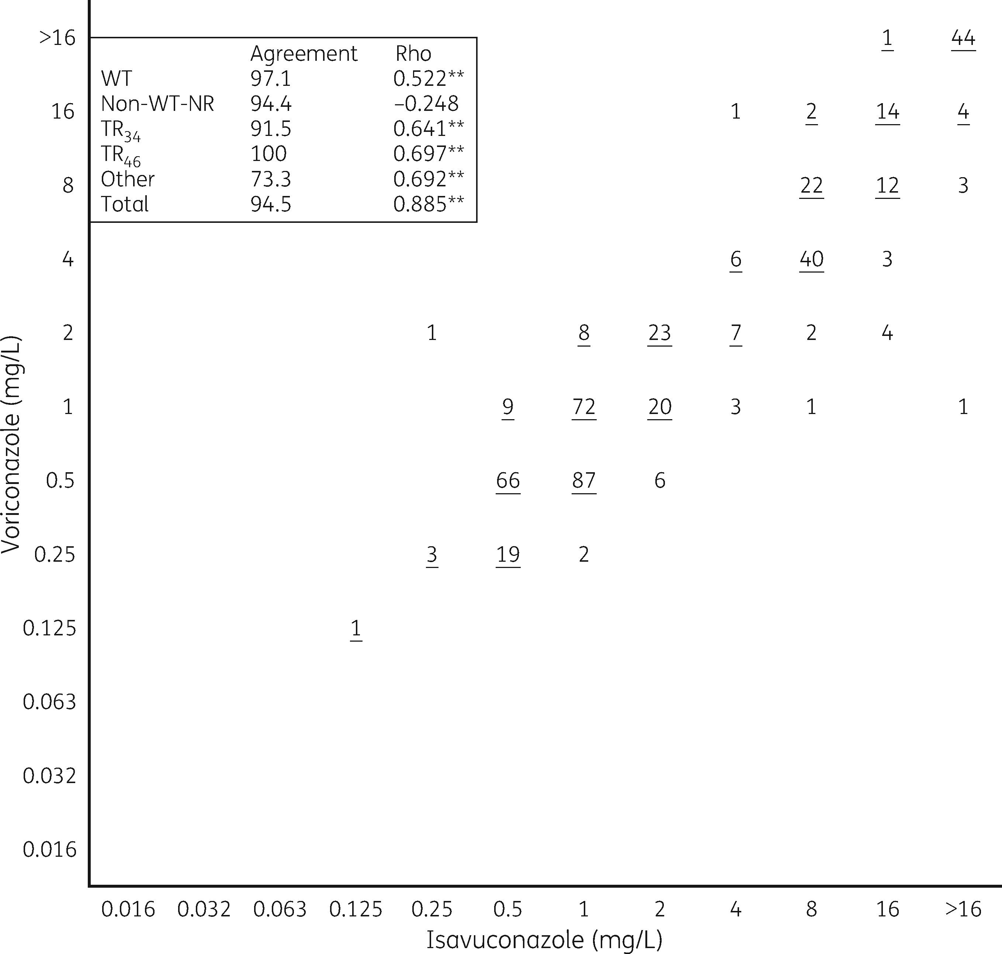
Use of the new azoles in the management of azole-resistant A. fumigatus
Isavuconazole and voriconazole MICs are highly correlated
(N=487 A. fumigatus isolates)
Expert opinion strongly recommends
a change of voriconazole monotherapy in documented azole-resistant disease to liposomal amphotericin B or a voriconazole/echinocandin combination, with echinocandins and polyenes typically being second-line choices for therapy in azole-susceptible disease
the same change in first-line therapy in areas with an environmental resistance rate ≥ 10%
liposomal amphotericin B in case of suspected azole-resistant CNS aspergillosis
Buil J, et al. J Antimicrob Chemother 2018; 73: 134-142
Douglas AP, et al. Intern Med J 2021; 51 (Suppl. 7): 143-176

Slide 30
Alternative strategies
¹High-dose posaconazole guided by therapeutic drug monitoring (target through levels > 3 mg/L)
N=16; 4/7 patients with azole-R IPA survived
3 patients ceased treatment due to Grade 2 arterial hypertension, QTc prolongation, increased cardia troponin and Grade 3 left ventricular failure, and Grade 4 leukopenia
²Outpatient intermittent dosing of L-AmB (e.g., 5 mg/kg 3 times weekly)
10 azole-R IPA cases – 100-day mortality 0%
Renal toxicity was manageable
³Intraventricular L-AmB 1 mg/week
2 cases of azole-R proven cerebral aspergillosis (plus systemic therapy)
Investigational drugs
¹Schauwvlieghe A, et al. Mycoses 2020; 63: 122-130
2Van de Peppel RJ, et al. Medical Mycology 2020; 58: 874-880
³Schauwvlieghe A, et al. J Glob Antimicrob Resist 2020; 22: 354-357

Slide 31
#5. Fewer drug interactions with the newer azoles?

Slide 32
Inhibitory potential of azole antifungals on selected CYP450 iso-enzymes
Azole | CYP2C9 | CYP2C19 | CYP3A4
Fluconazole | ++ | +++ | ++
Itraconazole | 0 | 0 | +++
Voriconazole | + | ++ | +++
Posaconazole | 0 | 0 | +++
Isavuconazole | 0 | 0 | ++
Note: +, weak; ++, moderate; +++, strong
Drug interactions occur in approximately 30% of patients receiving anticancer therapy
Chau MM, et al. Intern Med J 2021; 51 (Suppl.7): 37-66

Slide 33
Mould-active azoles and drug interactions in humans
Isavuconazole is a moderate (> 2 and < 5 fold) CYP3A4 inhibitor.
Isavuconazole does not inhibit CYP2C9 or CYP2C19.
CYP3A4 substrate (oral administration) | N-fold increase in the AUC of the CYP3A4 substrate by the respective triazole
 | Isavuconazole (capsule) | Posaconazole (oral suspension) | Voriconazole (tablet)
Midazolam | ↑ 2 | ↑ 5 | ↑ 10
Cyclosporin | ↑ 1.3 | ↑ 2 | ↑ 1.7
Sirolimus | ↑ 2 | ↑ 9 | ↑ 11
Tacrolimus | ↑ 2.3 | ↑ 4.6 | ↑ 3
Townsend R. et al. Presented at the European Congress of Clinical Microbiology and Infectious Disease [ECCMID], Copenhagen, Denmark; April 25–28, 2015; P0216
Groll A. et al. Clin Pharmacol Drug Dev 2017; 6: 76-85

Slide 34
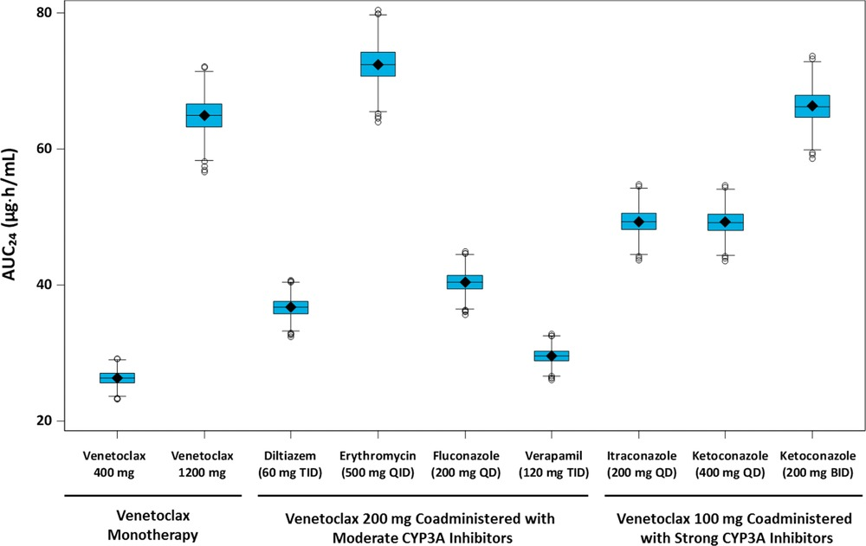
Quantitative Prediction of the Effect of CYP3A Inhibitors on Venetoclax Pharmacokinetics Using a Physiologically Based Pharmacokinetic Model
Freise KJ, et al. The Journal of Clinical Pharmacology 2017; 57: 796-804

Slide 35
#6. Newer azoles and sanctuary sites

Slide 36
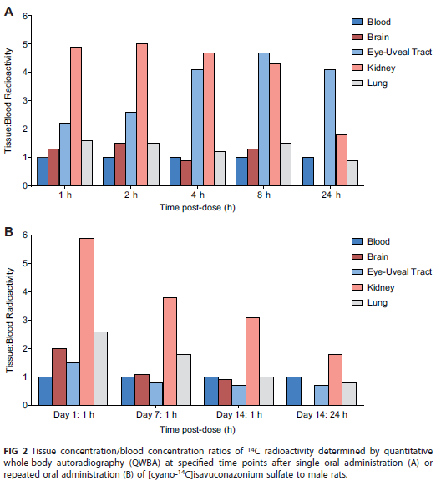
Isavuconazole: Tissue distribution
Isavuconazole is widely distributed in nearly all tissues
(including liver, lungs, eyes, kidneys, skin, bone, nasal mucosa and brain)
Schmitt-Hoffmann, et al. Tissue Distribution and Elimination of Isavuconazole following Single and Repeat Oral-Dose Administration of Isavuconazonium Sulfate to Rats.
Antimicrob Agents Chemother. 2017; 22;61(12) e01292-17.

Slide 37
Sanctuary site mould infections
Tissue to plasma ratios of antifungal drugs for sanctuary sites
Drug | Bone | Brain | Cerebrospinal fluid | Eye
Fluconazole | 0.3 | 0.5-1.0 | 0.5-1.0 | 0.7-0.8
Itraconazole | 4.7 | < 0.2 | < 0.12 | <0.05
Voriconazole | 5 | 3.0 | 0.22-1.0 | 0.4-0.5
Posaconazole | No data | 0.5-0.8 | <0.009 | 0.2-0.6
Isavuconazole (animal model) * |  | 1.35
“With low and/or highly variable penetration across all agents, there
is uncertainty around how to adequately dose triazoles in CNS infections”
Chau M, et al. Intern Med J 2021; 51 (Suppl.7): 37-66
* Wiederhold NP, et al. Antimicrobial Agents Chemother 2016; 60: 5600-5603

Slide 38
Isavuconazole and diffusion in infected human brain
CLL patient with cerebral aspergillosis (MIC ISA 1 mg/L)
Plasma concentration ISA at 300 mg/day: 4,3 mg/L and 3,2 mg/L
CSF concentration: undetectable
Normal brain tissue: 0,405 mg/L
Inflamed dura mater: 2,62 mg/L
Fungal abscess: 5,11 mg/L and 5,09 mg/L
CGD patient with cerebral aspergillosis
Plasma concentration ISA at 200 mg/day: 5,6 mg/L
Non-infected cerebellar tissue: undetectable
Cystic wall: 0,79 mg/L
AML patient with cerebral aspergillosis (MIC ISA 1 mg/L)
Plasma day 3 ISA 0,6 mg/L
Plasma day 6 ISA 2,9 mg/L
Brain tissue day 4 ISA 1,46 mg/L
ISA in the abscess fluid: 0,02 mg/L
Estimated brain/plasma concentration ratio as 0,9 (consistent with pharmacokinetic studies in rats)
Conclusion:
Isavuconazole concentrations in infected brain tissue are close to the corresponding serum concentrations (should we push the dose?) but concentrations are low in non-infected tissue
Isavuconazole does not always penetrate the abscess; surgery is still required in most cases
Rouzaud C et al. AAC 2019; 63: e02474-18
Lamoth F et al. JAC 2019; 74: 1751-53

Slide 39
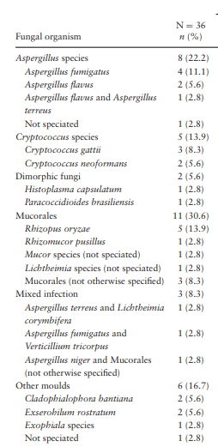
Isavuconazole and central nervous system fungal disease
80.6%
69.4%
Schwartz S, et al. Isavuconazole for the Treatment of Patients With Invasive Fungal Diseases Involving the Central Nervous System. Med Mycol 2020 Jun 1;58(4):417-424.

Slide 40
#7. Isavuconazole and QT/QTc

Slide 41
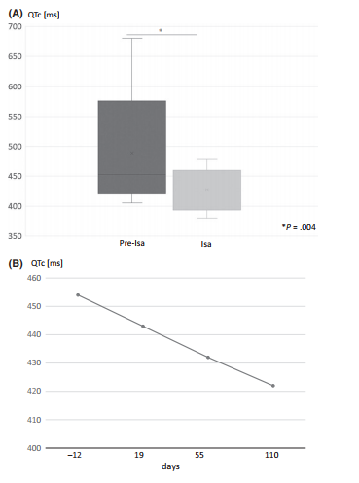
Isavuconazole shortens the QTc interval
QTc changes in 26 patients before (pre-ISA) and under treatment with isavuconazole (ISA): mean decrease of 36.5 ± 38.8 ms (range 7–202 ms)
QTc intervals in a patient with long-term isavuconazole treatment
Isavuconazole is contra-indicated in patients with short QT syndrome
Mellinghoff SC, et al. Isavuconazole shortens the QTc interval. Mycoses. 2018;61(4):256-260.

Slide 42
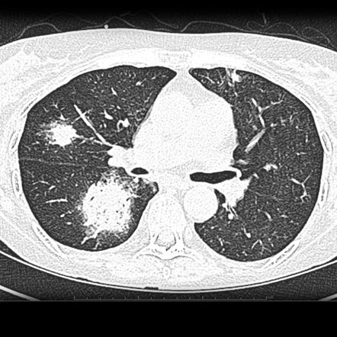
Prophylaxis Breakthrough invasive fungal infections and resistance
Patient on mold active prophylaxis with new pulmonary nodule(s)
= possible bIMD
Invasive Mold Disease (~ 50%)
Azole-S
Aspergillus spp.
Mucorales
Fusarium spp.
Scedosporium spp.
Lomentospora spp.
Mimickers of IMD
(~ 50%)
Infectious
Non-infectious
Azole-R
Aspergillus spp.
Low serum drug concentration
Sanctuary site
Acquired or intrinsic resistance
Non-Aspergillus mold intrinsically resistant
P. Aeruginosa
S. Maltophilia
K. Pneumoniae
Mycobacteria
Nocardia
Lymphoma
PTLD
Cancer
Thromboembolism
bIMD; breakthrough invasive mold disease

Slide 43
Guidance on treatment of specific breakthrough organisms
Breakthrough organisms | Preferred regimen for azole breakthrough | Guidance reference
Aspergillus spp. | Liposomal amphotericin B pending susceptibility testing and serum drug levels Switch to mold-active azole if susceptible Documented azole resistance MIC = 2 mg/L: voriconazole + echinocandin or liposomal amphotericin B MIC > 2 mg/L: Liposomal amphotericin B | Ullmann et al. Clin Microbiol Infect 2018; 24 Suppl 1:e1-e38
Mucorales | Liposomal amphotericin B 5 mg/kg/day (10 mg/kg/day in case of CNS disease) IV isavuconazole or posaconazole as alternative or step-down | Cornely et al. Lancet Infect Dis 2019; 19(12):e405-e421.
Fusarium spp. | Liposomal amphotericin B 3-10 mg/kg/day ± voriconazole or posaconazole (TDM required) | Hönigl et al. Lancet Infect Dis 2021; 21(8):e246-e257

Slide 44
The dilemma with azole antifungals and new targeted therapies
Good
AmBisome as the drug of choice in case of:
Intolerance
Acute or chronic toxicities
Documented or suspected azole resistance
Problematic drug–drug interactions
Non-Aspergillus moulds
Central nervous system infections
Breakthrough infection
Voriconazole
Efficacy of the drug
Liposomal
Amphotericin B
Posaconazole
Isavuconazole
Echinocandins
Poor
Low
High
Potential for drug interactions
Bruggemann, et al. Clin Infect Dis. 2009 ;48:1441–1458. J. Maertens, personal opinion

Slide 45
Isavuconazole treatment for mucormycosis (VITAL) A single-arm open-label trial and case-control analysis
Enrolled
N=149
Not treated
N=3
ITT/Safety
N=146
Renally impaired
N=59
Non-renally impaired
N=87
Safety
N=59
mITT- Mucorales
N=11
Safety
N=87
mITT- Mucorales
N=26
Intent-to-treat (ITT)/Safety: Received at least one dose of study medication
mITT-Mucorales: Subset of ITT patients with proven/probable mucormycosis (DRC-assessed)
Marty FM. et al. Lancet Infect Dis 2016; 16(7):828-37

Slide 46
Isavuconazole treatment for mucormycosis (VITAL) DRC-assessed overall response (mITT-Mucorales)
Outcome (%) | Primary N=21 | Refractory N=11 | Intolerant N=5 | Total N=37
DRC-assessed OR through Day 42 (primary endpoint)
Complete response | 0 | 0 | 0 | 0
Partial response | 3 (14%) | 1 (9%) | 0 | 4 (11%)
Stable disease | 9 (43%) | 4 (36%) | 3 (60%) | 16 (43%)
Progression of disease | 1 (5%) | 0 | 0 | 1 (3%)
Deaths | 7 (33%) | 4 (36%) | 2 (40%) | 13 (35%)
Missing data | 1 (5%) | 2 (18%) | 0 | 3 (8%)
DRC: Data Review Committee
mITT-Mucorales: Subset of ITT patients with proven/probable mucormycosis (DRC-assessed)
OR: Overall response
Marty FM. et al. Lancet Infect Dis 2016; 16(7):828-37

Slide 47
Isavuconazole treatment for mucormycosis (VITAL) DRC-assessed overall response (mITT-Mucorales)
Outcome (%) | Primary N=21 | Refractory N=11 | Intolerant N=5 | Total N=37
DRC-assessed OR through Day 42 (primary endpoint) |  |  |  |  | EOT (N=35)
Complete response | 0 | 0 | 0 | 0 | 5/35 (14%)
Partial response | 3 (14%) | 1 (9%) | 0 | 4 (11%) | 6/35 (17%)
Stable disease | 9 (43%) | 4 (36%) | 3 (60%) | 16 (43%) | 10/35 (29%)
Progression of disease | 1 (5%) | 0 | 0 | 1 (3%) | 14/35 (40%)
Deaths | 7 (33%) | 4 (36%) | 2 (40%) | 13 (35%)
Missing data | 1 (5%) | 2 (18%) | 0 | 3 (8%)
DRC: Data Review Committee
mITT-Mucorales: Subset of ITT patients with proven/probable mucormycosis (DRC-assessed)
OR: Overall response
EOT: End of treatment
Marty FM. et al. Lancet Infect Dis 2016; 16(7):828-37

Slide 48
Isavuconazole treatment for mucormycosis (VITAL) All-cause mortality (mITT-Mucorales)
Outcome (%) | Primary N=21 | Refractory N=11 | Intolerant N=5 | Total N=37
ACM through Day 42 | 7 (33.3) | 5 (45.5) | 2 (40.0) | 14 (37.8)
Deaths | 7 (33.3) | 4 (36.4) | 2 (40.0) | 13 (35.1)
Unknown survival status | 0 | 1 (9.1) | 0 | 1 (2.7)
ACM through Day 84 | 9 (42.9) | 5 (45.5) | 2 (40.0) | 16 (43.2)
Deaths | 7 (33.3) | 4 (36.4) | 2 (40.0) | 15 (40.5)
Unknown survival status | 0 | 1 (9.1) | 0 | 1 (2.7)
ACM: All cause mortality
mITT-Mucorales: Subset of ITT patients with proven/probable mucormycosis (DRC-assessed)
Marty FM. et al. Lancet Infect Dis 2016; 16(7):828-37

Slide 49
Isavuconazole treatment for mucormycosis (VITAL) All-cause mortality (mITT-Mucorales)
Kaplan-Meier analysis of patients who received isavuconazole as primary treatment (VITAL) compared with amphotericin B-treated matched controls (FungiScope)
1.0
0.8
0.6
Survival probability
0.4
Isavuconazole | (N=21)
Amphotericin B formulation | (N=33)
0.2
0.0
1
7
14
21
28
35
42
49
56
63
70
77
84
Days
Number of subjects at risk
Isavuconazole | 21 | 17 | 17 | 16 | 16 | 14 | 14 | 14 | 14 | 13 | 12 | 12 | 12
Amphotericin B | 33 | 26 | 26 | 25 | 22 | 20 | 20 | 20 | 18 | 16 | 16 | 14 | 14
Case matching criteria
Severe disease (CNS involvement or disseminated)
Hematologic malignancy
Surgery (resection or debridement) within 7 days
Marty FM. et al. Lancet Infect Dis 2016; 16(7):828-37

Slide 50
Mortality in mucormycosis
Treated
Untreated
Literature
n/N
n/N
Roden et al 2005
244/648
233/241
Skiada et al 2011
58/152
21/22
FungiScope
Day 42
41/107
29/29
Meta-Analysis
Roden/Skiada/FungiScope
343/907
283/292
VITAL study
All Patients – Day 42
14/37
Primary Therapy – Day 42
7/21
Mortality Rate %, (95% CI)
Roden MM, et al. Clin Infect Dis 2005; 41: 634-653
Skiada A, et al. Clin Microbiol Infect 2011; 17: 1859-1862
Rüping MJ, et al. J Antimicrob Chemother 2010; 65: 296-302
FDA, Advisory Committee Briefing Document, Jan 22, 2015

Slide 51
INQUIRE registry data on invasive mucormycosis and invasive aspergillosis (non-fumigatus)
Thompson GR III, et al. Mycoses 2022; 65: 186-198

Slide 52
First-line invasive mucormycosis: recommendations
Isavuconazole and Posaconazole
have species-specific activity within the Mucorales group
IV, intravenous; SOT, solid organ transplant.
Cornely O, et al. Lancet Infect Dis. 2019; 19:e405–e421.

Slide 53
Conclusion
Isavuconazole appears to be the best tolerated of the 3 currently available newer generation mould-active azoles, but there is considerably less clinical experience with it than either voriconazole or posaconazole, and it has taken years of accumulated clinical experience for several important toxicities of voriconazole and posaconazole to make themselves apparent
Isavuconazole and posconazole are not drugs of choice for the primary treatment of documented mucormycosis
Unlike voriconazole, isavuconazole lacks activity against Scedosporium species and most Fusarium isolates

Slide 54
THANK YOU FOR LISTENING!!

