Slide 1
Antifungal Dosing and Therapeutic Drug Monitoring
Andrew J. Ullmann, MD, FIDSA
Julius-Maximilians-Universität
Department of Internal Medicine II
Division of Infectious Diseases
Würzburg, Germany
andrew.ullmann@uni-wuerzburg.de

Slide 2
Disclosure of Potential Conflicts of Interest:
1. Employment or Leadership Position
None
2. Advisory Role
Basilea, Pfizer, MSD, Astellas, Gilead, Aicuris
3. Stock Ownership
None
4. Honoraria
Astellas, Gilead, MSD, Astellas, and Pfizer
5. Financing of Scientific Research
Astellas, Gilead, MSD, Astellas, Pfizer, and BioCryst
6. Expert Testimony
None
7. Other Financial Relationships
none

Slide 3
TDM = therapeutic drug monitoring
Important to adjust dosage for toxicity
and/or
Adjust dosage for efficacy
or just for academic purposes?

Slide 4
Topics
What do we know about TDM and
Flucytosine
Itraconazole
... and what about the newer ones?
Voriconazole
Posaconazole

Slide 5
What is the story about the old antifungal agents?
Flucytosine:
Pyrimidine analog
Limited to combination therapy (e.g. AmB)
Oral absorption reliable
Wide inter- and intrapatient PK variation
Relatively rapid half-linfe: 3-6h
Weight based dosing: 150mg/kg (divided in 4 doses)
Target levels (mg/L):
non-neonates (trough 30–40, peak 70–80);
neonates (trough 20–40, peak 50–80)
All levels >100 mg/L are considered potentially toxic
Reviewed in Smith et al. Ther Drug Monit 2008
Notes:
>50% of the time above the MIC and
Samples 30 min iv and 2h post oral

Slide 6
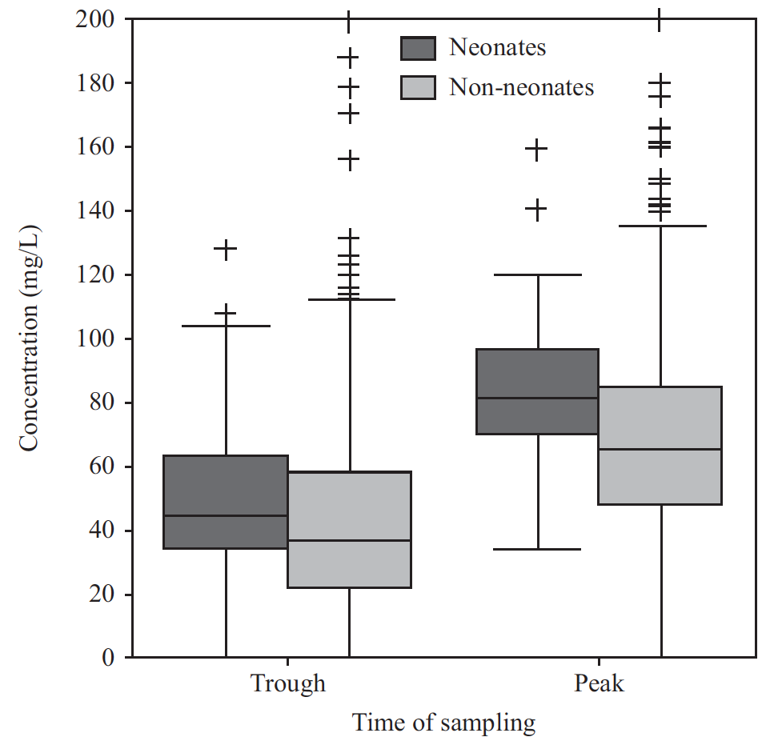
What is the story about the old antifungal agents?
Flucytosine:
only 20.5% of flucytosine levels were in the expected therapeutic range
Levels were low in 40.5% (i.e. trough <20 mg/L or peak <50 mg/L for neonates; trough <30 mg/L or peak <70 mg/L for non-neonates)
High levels were observed in 38.9% (i.e. any trough level >40 mg/L or peak >80 mg/L), of which 9.9% were potentially toxic levels (.100 mg/L).
60.8% versus 37.3%; P < 0.001
Pasqualotto et al. AAC 2007
Notes:
evaluate all flucytosine levels performed in a regional centre in the UK from October 1991 to May 2006
>50% of the time above the MIC and
Samples 30 min iv and 2h post oral
The persistence of levels in the potentially toxic range for >2 weeks was documented for only six patients (2.6%).

Slide 7
What is the story about the “old” antifungal agents?
Itraconazole:
Broad spectrum antifungal triazole
Three formulations (suspension, capsule, and iv)
Suspension: w/o a meal (NPO)
Capsule: with a meal, Dosage 200mg twice daily
Large variation in PK
Long half-life: 24h
Mean conc. (oral) 741 ng/L
In bioassay
Coccidioidomycosis: 6.5 +4.2 mg/L w/ success, 4.0 +3.2 mg/L w/o response;
Crypto: >1mg/L
Animal data IA: 6.5mg/L vs 4.5mg/L
Prophylaxis in N/F: >.25 - .5mg/L less infections
Reviewed in Smith et al. Ther Drug Monit 2008
Notes:
>50% of the time above the MIC and
Samples 30 min iv and 2h post oral
The persistence
of levels in the potentially toxic range for .2 weeks was
documented for only six patients (2.6%).

Slide 8
... and what about the “younger” kids on the block?
Voriconazole

Slide 9
Voriconazole Non-linear Pharmacokinetics
Due to saturation of metabolism (Michaelis-Menten kinetics)
Greater than proportional increase in exposure with increasing dose
On average, 1.5-fold oral dose escalation from 200 mg q 12 h to 300 mg q 12 h will lead to a 2.5-fold increase in exposure
Average Steady State
Plasma Concentration (μg/ml)
Twice Daily Dose (mg)

Slide 10
Voriconazole
Two formulations: oral and iv
Oral bioavailability of 96%
Volume of distribution of 4.6 L/kg
Plasma protein binding 58%

Slide 11
Voriconazole Factors Influencing Pharmacokinetic Variability
CYP2C19 genotype
Race
Gender and age in adults
Children (2 - < 12 years)
Body weight
Hepatic impairment
Renal impairment
Concomitant medications

Slide 12
Incidence of treatment failure and visual or auditory hallucinations below and above voriconazole concentration limits
Dolton et al. AAC 2012
Retrospective multicenter study:
N=201, 783 samples
Notes:
This multicenter retrospective study aimed to investigate relationships between voriconazole concentration and clinical outcomes and adverse events and to assess clinical factors and drug interactions that may affect voriconazole concentration. Medical records were reviewed for patient who received voriconazole and had at least 1 concentration measured at seven hospitals in Australia. The study included 201 patients with 783 voriconazole trough concentrations.

Slide 13
Comparison of recommended lower and upper target voriconazole concentration limits from voriconazole TDM studies
Dolton et al. AAC 2012

Slide 14
Factors associated with a significant change in voriconazole concentration identified from multiple linear regression analysis
Dolton et al. AAC 2012
Notes:
This multicenter retrospective study aimed to investigate relationships between voriconazole concentration and clinical outcomes and adverse events and to assess clinical factors and drug interactions that may affect voriconazole concentration. Medical records were reviewed for patients who received voriconazole and had at least 1 concentration measured at seven hospitals in Australia. The study included 201 patients with 783 voriconazole trough concentrations.

Slide 15
Voriconazole Concentrations after Allogeneic Hematopoietic Stem Cell Transplantation
Trifilioet al AAC 2009

Slide 16
Voriconazole Concentrations after Allogeneic Hematopoietic Stem Cell Transplantation
Approx 40% had 6-1865% variation between initial and follow-up sample
Trifilio et al AAC 2009
There is a lack of correlation if the initial level is <2 µg/ml and significant correlation if the initial level is >2 µg/ml.
N=64, pair samples
Notes:
Only oral voriconazole, at least 6 days of vori for prophylaxis
Approx 40% had 6-1865% variation between initial and follow-up sample

Slide 17
Voriconazole trough plasma concentrations and probabilities predicted by the logistic regression models for response of infection to therapy and grade 3 associated neurotoxicity
Pascual et al. CID 2012
N=55
505 samples
Notes:
Switzerland

Slide 18
Population-based simulation: Probability of Achieving Different Voriconazole Trough Plasma Concentrations Targets With 200, 300, and 400 mg Twice-Daily Oral and Intravenous Dosing Regimens
Pascual et al. CID 2012
The doses were adjusted (50% increase/decrease) in case of nonresponse of IFI and toxicity with trough plasma concentrations ≤1 and ≥5.5 mg/L, respectively

Slide 19
Voriconazole Dose Adjustment
Adjusted 24–48 hours after blood sampling based on the results of TDM.
Target trough concentration range (1.0–5.5 mg/L)
Determined to be the fourth day after the initiation of therapy
Dosage increased by 100% if the trough level was <1.0 mg/L
Dosage was lowered by 50% if the trough level was >5.5 mg/L and there was no drugrelated adverse event.
Trough level was >10.0 mg/L or if an adverse event was suspected in a patient with a level >5.5 mg/L, one dose was skipped and subsequent doses were reduced by 50%
Park et al. CID 2012

Slide 20
Initial or final voriconazole trough level
solid circle or square denotes a complete response
x indicates treatment failure
solid circle or square denotes a severe adverse event
Park et al. CID 2012
Randomized, assessor-blinded, controlled, single center trial, n=110

Slide 21
...and there is another azole out there
Posaconazole

Slide 22
Exposure After Single-Dose Administration
70
60
50
40
AUC_{(I)} (ng·h/mL), thousands
Courtney RD et al. Antimicrob Agents Chemother. 2003;47:2788-2795.
30
20
R² = 0.99
(50–800 mg)
10
0
0
200
400
600
800
1000
1200
Dose (mg)
Notes:
Reference
Courtney RD, Pai S, Laughlin M, Lim J, Batra V. Pharmacokinetics, safety, and tolerability of oral posaconazole single and multiple doses in healthy adults. Antimicrob Agents Chemother. 2003;47:2788-2795.
#3; C
#143; D

Slide 23
Absorption With Solid Food
600
500
Fasted
Nonfat meal
High-fat meal
400
300
Posaconazole (ng/mL)
200
Courtney R et al. Br J Clin Pharmacol. 2004;57:218-222.
100
0
0
12
24
36
48
60
72
Time (h)
Notes:
Reference
Courtney R, Wexler D, Radwanski E, Lim J, Laughlin M. Effect of food on the relative bioavailability of 2 oral formulations of posaconazole in healthy adults. Brit J Clin Pharm. 2004;57:218-222.
#144; D

Slide 24
Dividing the Dose of Posaconazole Increases Absorption Fasted Healthy Volunteers
450
200 mg four times daily
400
400 mg twice daily
350
800 mg once daily
300
Posaconazole Plasma Concentration (ng/mL)
250
200
150
Ezzet F et al. Clin Pharmacokinet. 2005;44:211-220.
100
50
0
0
4
8
12
16
20
24
28
32
36
40
44
48
Time (h)
Notes:
Methods: The pharmacokinetics of posaconazole in fasted healthy subjects were evaluated in this randomized, open-label, 3-way crossover study in 18 healthy men.¹ Following an overnight fast, subjects were assigned to receive 1 of 3 regimens of posaconazole oral suspension: a single 800-mg dose, 2 doses of 400 mg (given 12 hours apart) or 4 doses of 200 mg (given 6 hours apart). All subjects completed each of the 3 administration periods, which were separated by 1-week washout periods. Blood samples were collected for determination of posaconazole concentration at predose (0 hour) and up to 48 hours postdose.
Summary: Under fasted conditions, dividing the daily dose of posaconazole increased oral absorption. Although posaconazole was well absorbed following all 3 dosing regimens, bioavailability was increased 98% with twice-daily dosing and 220% with 4-times-daily dosing relative to once-daily dosing.
The data also suggest that absorption of the 800-mg daily dose is maximized by dividing the dose. These results, together with findings from another pharmacokinetic trial showing posaconazole absorption was saturated at doses above 800 mg,² provided the rationale for posaconazole dosing regimens in clinical trials. These data in fasting volunteers are of particular importance for seriously ill patients who may have poor oral food intake.
Posaconazole should be administered at a dose of 400 mg (10 mL) twice daily with a meal or with 240 mL of a nutritional supplement. In patients who cannot tolerate a meal or a nutritional supplement, posaconazole should be administered at a dose of 200 mg (5 mL) four times daily.³ However, in the presence of food, the difference in exposure between 400 mg twice daily and 200 mg four times daily is less striking.
References
1. Ezzet F, Wexler D, Courtney R, Lim J, Laughlin M. The oral bioavailability of posaconazole in fasted healthy subjects: basis for clinical dosage recommendations. Clin Pharmacokinet. 2005;44:211-220.
Courtney RD, Pai S, Laughlin M, Lim J, Batra V. Pharmacokinetics, safety, and tolerability of oral posaconazole administered in single and multiple doses in healthy adults. Antimicrob Agents Chemother. 2003;47:2788-2795.
Noxafil [summary of product characteristics]. Brussels, Belgium: SP Europe; 2006.

Slide 25
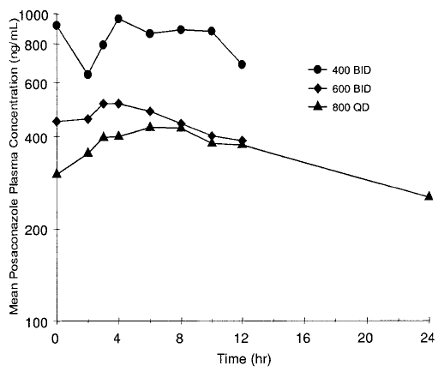
Mean posaconazole plasma concentration-time profile on day 10 in patients receiving 400 mg b.i.d., 600 mg b.i.d., or 800 mg q.d. posaconazole oral suspension.
Ullmann AJ et al. AAC 2006

Slide 26
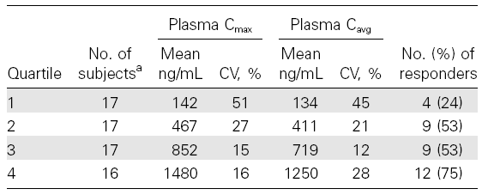
Response Pharmacokinetic
Walsh et al. CID 2007
Notes:
Cavg, average plasma concentration; Cmax, maximum plasma concentration;
CV, coefficient of variation.
a Data were available for 67 patients with available plasma concentrations
of posaconazole.

Slide 27
Posaconazole
Serum Levels and Clinical Outcomes
Comparison of posaconazole and fluconazole / itraconazole as prophylaxis for IFI in patients with neutropenia¹
*C_{avg}: 583 ± 381 ng/ml
Comparison of posaconazole and fluconazole as prophylaxis for IFI in patients with GVHD
*C_{avg}: 1,103 ± 744 ng/ml
MIC₉₀ for most Aspergillus spp. is ~500ng/ml
1.Cornely et al. NEJM 2007;356:348-359
2. Ullmann et al. NEJM 2007;356:335-347
3. Jang et al. Clin Pharm & Ther 2010;88:115-119
4. Sabatelli et al. Antimicrob Agents Chemother 2006;50:2009-2015
Notes:
Oral azole agents are frequently used as agents against invasive fungal infections (IFIs). Note: Voriconazole does not have a licence within the UK for prophylaxis against invasive fungal infections¹.
Voriconazole is a relatively polar molecule and concentrates minimally within host cells^{2,}. Serum levels of voriconazole between 1µg/ml and 5µg/ml have been reported to correlate well with efficacy^{3,4}.
In contrast, posaconazole is significantly more lipophilic but while its serum levels are lower than those reported with voriconazole, levels of posaconazole have been reported to concentrate to high levels within cells (up to 40- 50-fold)^{5,6}.
Despite relatively low serum levels for posaconazole (C_{avg} 0.5 to 1.0µg/ml or C_{avg} 50-100ng/ml)⁷ clinical outcomes as antifungal prophylaxis are proven^{8,9}
However, the correlation between serum levels and efficacy of posaconazole in antifungal prophylaxis has been the subject of some debate.^{10,11}
So how are these data reconciled? Particularly, when the MIC levels of posaconazole for most species of Aspergillus is ~ 50ng/ml (or 0.50µg/ml)¹²
1. Voriconazole SPC; downloaded April 2012
2. Ballesta et al. J Antimicrob Chemother 2005;55:785-787
3. Pascual et al. Clin Infect Dis 2008;46:201-211
4. Smith et al. Antimicrob Agents Chemother 2006;50:137-143
5. Conte et al, Antimicrob Agents Chemother 2009;53:703-707
6. Crandon et al. Antimicrob Agents Chemother 2009;53:5102-5107
7. Jang et al. Clin Pharmacol Ther 2010;88:115-1
8. Cornely et al. NEJM 2007;356:348-359
9. Ullman et al. NEJM 2007;356:335-347
10. Cornely & Ullman Clin Pharmacol Ther 2011;89:351-352
11. Hussaini et al. Pharmacother 2011;31:214-225
12. Sabatelli et al. Antimicrob Agents Chemother 2006;50:2009-2015

Slide 28
Some data from the “real world”

Slide 29
Predicted probability of breakthrough fungal infection determined from logistic regression
N=72, with >1 sample
17% developed breakthrough IFI
median 289 mg/mL (range: 50 – 471 ng/mL)
versus
median 485 ng/mL (0 - 2035 ng/mL)
Dolton et al AAC 2012

Slide 30
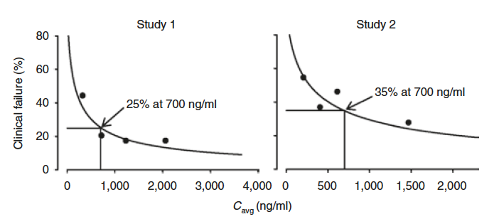
Posaconazole serum concentration - response relationship for patients receiving prophylaxis
Jang HS et al. Clinical pharmacology & Therapeutics 2010
Notes:
Study 1: GVHD
Study 2: AML

Slide 31
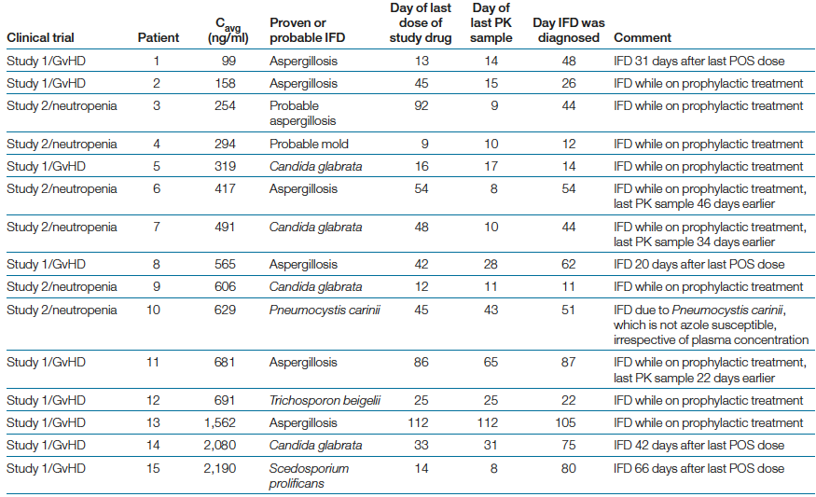
So why did prophylaxis work?
Cornely OA; Ullmann AJ Clinical Pharmacology & Therapeutics 2011

Slide 32
Pharmacokinetics and Intracellular Concentrations
Posaconazole AUC/MIC: up to several 100 fold higher in the cell membran compared to serum
 | Posaconazole^{*1} | Voriconazole^{⌃2}
Plasma | 2.08 µg/ml | 2.2 µg/ml
Alveolar cells | 87.7 µg/ml | 14.4 µg/ml
* Posaconazole: 14 doses of 400mg (bd) over 8 days
⌃Voriconazole: IV loading dose of 6mg/kg bd on day 1;
maintenance dose of 4mg/kg bd on day 2; single dose of 4mg/kg on day 3
Plasma C_{max} of voriconazole is greater than for posaconazole
BUT posaconazole concentrates highly inside alveolar cells
1. Conte et al, Antimicrob Agents Chemother 2008;53(2):703-707
2. Crandon et al. Antimicrob Agents Chemother 2009;53:5102-5107
Notes:
In structural terms, the main difference is it that posaconazole is a very lipid soluble agent. voriconazole is not, which effects volume distribution.¹
Conte et al.² evaluated the pharmacokinetics and pharmacodynamics of posaconazole in an open-label study. 25 subjects received 14 doses of posaconazole as oral suspension (400mg) over an 8-day period. They analysed pulmonary epithelial lining fluid (ELF) and alveolar cell samples, obtained via bronchoalveolar lavage; blood samples were collected after the last dose. The levels of posaconazole are shown in the table above. plasma concentrations in plasma, ELF and alveolar cells did not decrease significantly, indicating slow elimination after multiple dosing.
Crandon et al^{.3} similarly evaluated voriconazole in 20 healthy subjects over a 3-day period were randomised for collection of bronchoalveolar lavage. Voriconazole IV was given as a loading dose of 6mg/kg bd on day 1 followed by a maintenance dose of 4mg/kg bd on day 2 and a single dose of 4mg/kg on day. Levels of voriconazole in ELF and alveolar macrophages were analysed.
The C_{max} for posaconazole in plasma was 2.08µg/ml and the volume distribution for posaconazole in the cells was 40- to 50-fold concentration of that in the blood. However, for a similar level of voriconazole in the plasma (2.2µg/ml), there was a relatively small variation in concentration of that in the cells.^{2,3}
1. Campoli et al. Antimicrob Agents Chemother 2011;55:5732-573
2. Conte et al, Antimicrob Agents Chemother 2008;53(2):703-707
3. Crandon et al. Antimicrob Agents Chemother 2009;53:5102-5107

Slide 33
Posaconazole TDM Issues
Higher plasma concentration of posaconazole is associated with improved clinical response in patients with established invasive fungal disease
Predictors of low plasma posaconazole exposure is well established
TDM in prophylaxis seems to be different due to higher exposure posaconazole in host cell members.
TDM at day +3 may predict steady-state concentrations
Adjusting dosage above a cumulative daily dose of 800mg does not provide higher exposure => making TDM a challenge

Slide 34
Summary
 |  | Concentration outcome
Agent | Assay | Toxicity | Efficacy | PK Variability
5-FC | HPLC/BIO/Enz | Yes | Yes | Yes (renal)
Itraconazole | HPLC/Bio | No | Yes | Yes (absorption)
Voriconazole | HPLC/Bio | Yes | Yes | Yes (metabolism)
Posaconazole | HPLC/Bio | No | Yes | Yes (absorption)
AmB | HPLC/Bio | No | Yes(animal) | No
Echinocandins | HPLC/Bio | No | Yes | No
Fluconazole | HPLC/Bio | No | Yes (animal) | No
Reviewed in Smith et al. Ther Drug Monit 2008

Slide 35
www.TIMM2013.org
Save the date!
11-14 October 2013
Copenhagen, Denmark

